Slide 1
1. Introduction
2
38
65
82
110
127
149
163
2. Overview of Product management
3. Core concepts
4.1 Identifying opportunities v2
4.2 Assess opportunity
4.2.1 Risks assessment
4.3 Create business plan - Lean canvas
4.4. Specify product features - Story map

Slide 2


Software product management
Introduction
BITS Pilani
Nandagopal Govindan

Slide 3

Contents
Software products scenario
What is spurring product industry?
Different product categories
Project business vs Product business
What is Product management?
About this course

Slide 4
Software products scenario

Slide 5
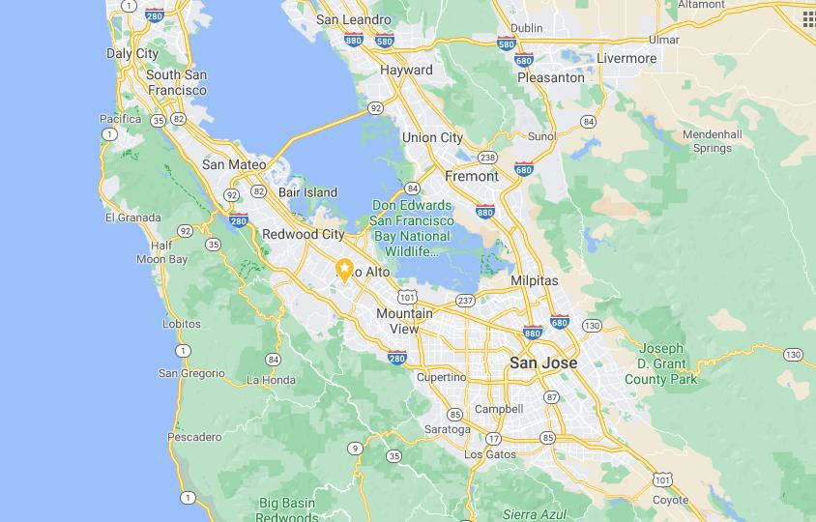
Software product revolution started in Silicon valley
Stanford University
Silicon valley
Early companies in Silicon valley: HP, Xerox, Apple, Oracle,…..

Slide 6
How Silicon Valley became successful?
Convergence of Academia (Stanford, UC Berkley), the Private
Sector, and Government
High Density of Wealthy Investors and Funding Institutions
Inspiration From Past Success Stories
Cultural diversity: Half the startups belong to Indians and Chinese
Level-headed Approach to Failure

Slide 7
Today there are 950+ unicorns across the world
Country | # of Unicorns
United States | 300+
China | 140+
India | 50+
United Kingdom | 30+
Germany | 12
South Korea | 11
https://www.cbinsights.com/research-unicorn-companies

Slide 8
Unicorns by industry
Industry | # of Unicorns
Fintech | 80+
Internet software & services | 70+
E-commerce & direct-to-consumer | 70+
Artificial intelligence | 50+
Mobile & telecommunications | 35+
Health | 35+
https://www.cbinsights.com/research-unicorn-companies

Slide 9
Growth of start-ups in India
The number of start-ups has grown from 7,000 in 2008 to 50,000 in 2017, according to the latest report by KPMG on the startup ecosystem in india
KPMG report: https://home.kpmg/in/en/home/insights/2019/01/startup-landscape-ecosystem-growing- mature.html

Slide 10
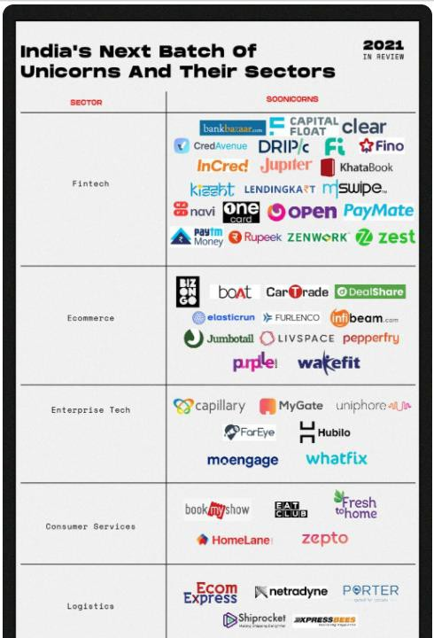

Slide 11
Upcoming unicorns start- ups in India
India has 73 potential unicorns in 2021, up from 52 soonicorns in 2020, with Bengaluru leading the list followed by Mumbai and Delhi-NCR
The emergence of new models in fintech, consumer services and ecommerce has revitalised funding in these sectors
As startups raise capital at high valuations, investors caution against short-term thinking around growth at the cost of unit economics
https://inc42.com/features/the-next-unicorns-soonicorn-startups-in-india/

Slide 12
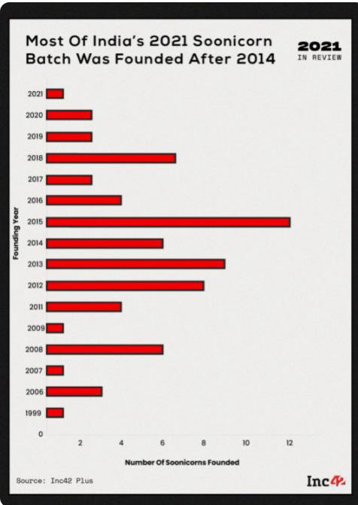
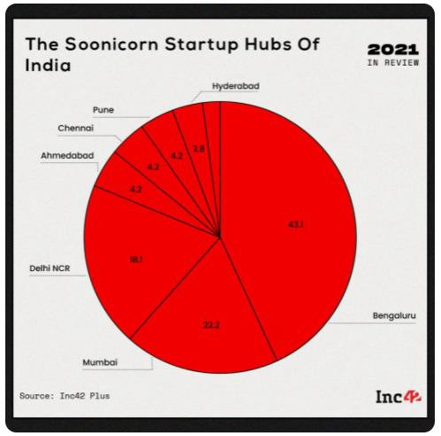

Slide 13
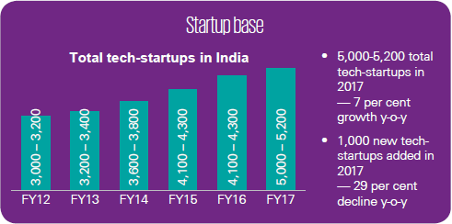
Tech start-ups growth in India
KPMG report: https://home.kpmg/in/en/home/insights/2019/01/startup-landscape-ecosystem-growing- mature.html

Slide 14
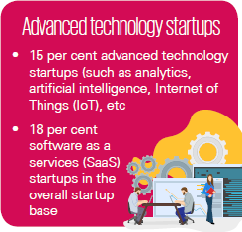
Tech start-ups – Advanced technology (India)
KPMG report: https://home.kpmg/in/en/home/insights/2019/01/startup-landscape-ecosystem-growing- mature.html

Slide 15
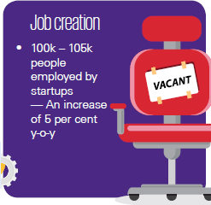
Tech start-ups – job creation (India)
KPMG report: https://home.kpmg/in/en/home/insights/2019/01/startup-landscape-ecosystem-growing- mature.html

Slide 16
What is spurring product industry?
Global market reach
Cloud resources – Amazon AWS, Microsoft Azure, IBM, Google
Funding - 100 angel investors in 2020
Talent pool

Slide 17
Unicorns in India
Courtesy: https://www.investindia.gov.in/indian-unicorn-landscape

Slide 18
Product categories

Slide 19
Product categories
By industry – Finance, Health, Retail, Travel
By technology – AI/ML, Analytics, Robotics, IoT
B2B vs B2C
SaaS vs On-premise
Mobile vs Web
Regular vs API products (Payment gateway, Google Maps, SMS gateway, Banking API)
Product vs Product-cum-service (Ola, Uber, Flipkart)
Product (Paytm), Product platform (Ola), Product family (Office on Windows, Office on Mac, Office on Android), Product Line (Roclwell Collin avionics)
Any other?

Slide 20
Industry segments
E-Commerce – Amazon, Flipkart
HealthTech – Practo, Tata Health, CogniAble
FinTech – Paytm, Wealthy
EdTech - Byju
TravelTech – MakeMyTrip, Tripadvisor
Logistics – Ecom express, Dunzo, Delhivery
Consumer services – Swiggy,
Enterprise Tech – Zoho, Kissflow, Wooqer
Deep tech - Niflr, Logically, AskSarkar
Software dev – Postman, WorkDuck

Slide 21
Product platform
Product platform: Amazon AWS, Android, Uber, PayPal,
Facebook
– The technical foundation / eco system on which several software products are
based.

Slide 22
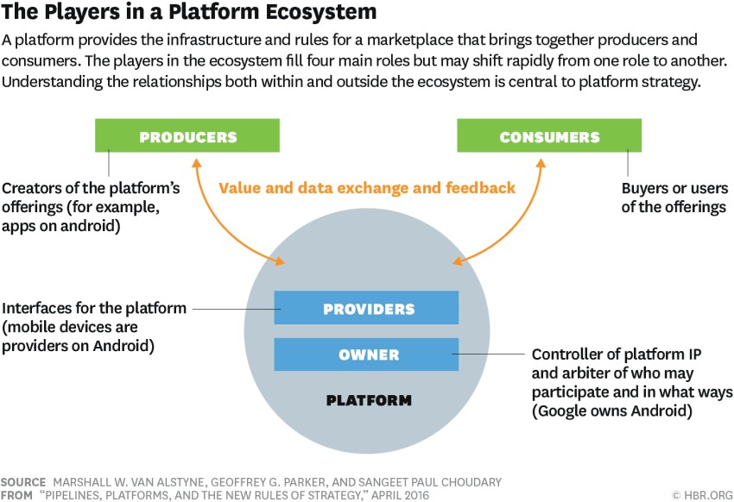
Product platform
Image Source: https://hbr.org/2016/04/pipeli nes-platforms-and-the-new- rules-of-strategy

Slide 23
Product family
Product family: Microsoft Office (Word, Excel,
PowerPoint, OneNote, Outlook)
– A group of software products that are marketed as belonging together under a
common family name

Slide 24
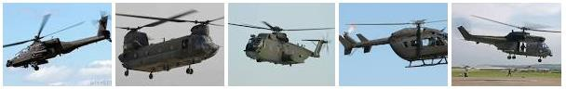
Product line
Product line: Rockwell Collins Avionics systems for
different helicopters
– a collection of similar software systems from a shared set of software assets
using a common means of production.

Slide 25

Product business and Project business
Dimension | Product | Project
Risk | High | Low
Returns | High | Low
Duration | Ongoing | Pre-determined
Customers | Many | One
Objective | Discovered | Given
Funding | Internal & external | Internal
Marketing effort | High | Low
Management | Strategic | Tactical / operational

Slide 26
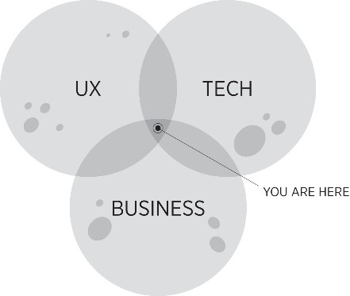
What is Product Management?
“The job of a product manager is to discover a product that is valuable,
usable and feasible.” – Marty Cagan, Author of ‘Inspired’
“Product management is an intersection between business, user experience, and technology” – Martin Eriksson, Author of Product Leadership
“Product management is the glue that holds together all the various
functions” - Ken Norton, Product Partner at Google Ventures

Slide 27
Product Management role
You need to be really good at strategy, be inspirational, and understand
the long-term picture.
At the same time, you have to be really good at the operational side and making things happen
Setting a vision
Creating a roadmap
Build the product
Talk to customers
You need the soft skills of persuasion, negotiation, storytelling, vision setting and communication

Slide 28
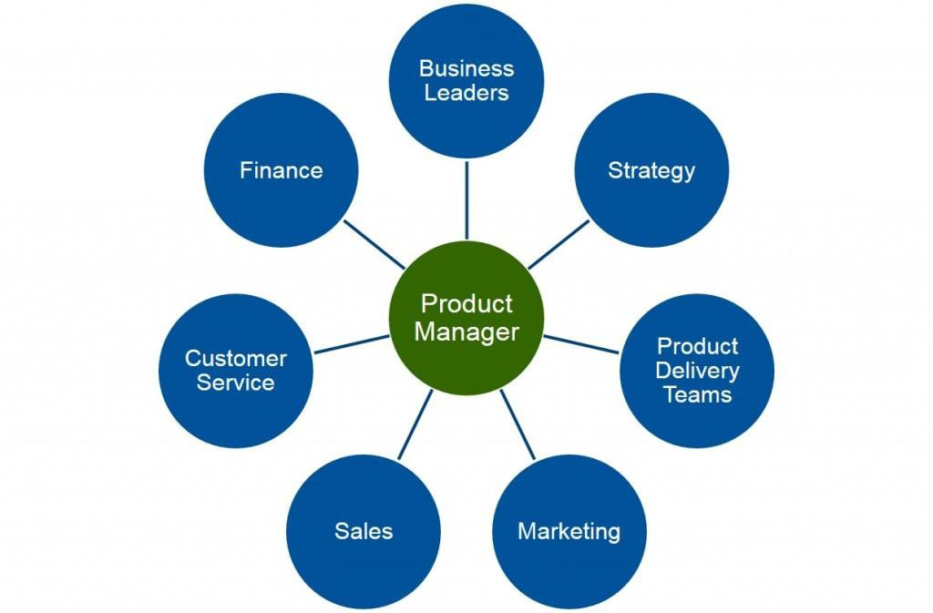
Product Management role
Ref: Product Plan.com

Slide 29
About the course
Hope you have handout.

Slide 30
Sharing thoughts
Name one product company you admire.
What is the reason you admire this company?

Slide 31
Appendix

Slide 32
Examples of Products
Zoom – Simplified Cisco Webex
Ola – Built a platform
Postman – Eco system for API development
Slack – Simplified Team collaboration
Twilio – Tool to Integrate messaging
Kissflow – Business workflow implementation easily
Rivigo – Innovation in logistics
MyGate – Spotted an opportunity

Slide 33

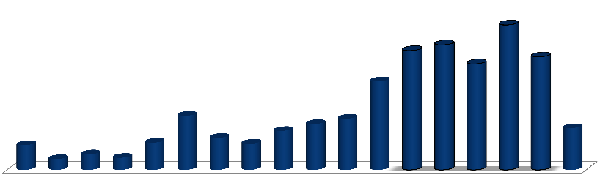
Since 1990, more than 3402 product companies have started in India; however, the YoY numbers vary dramatically due to various other economic variables
Evolution of the Indian Product Business Landscape from the year
1990 to 2012
Due the economic downturn, the number of new product startups reduced in 2009.
45
8
425
E
39
5
400
37
7
E35 7
28
0
33
5
17
1
14
5
16
2
10
1
12
3
13
2
78
86
83
34
49
38
Till
1995
1996 1997 1998 1999 2000 2001 2002 2003 2004 2005 2006 2007 2008 2009 2010 2011
Q2
2012
Total= 3402
Note: Only companies with visibility/beta product , live in the market have been considered in the database.; E - Estimated Source: Zinnov Analysis
1

Slide 34
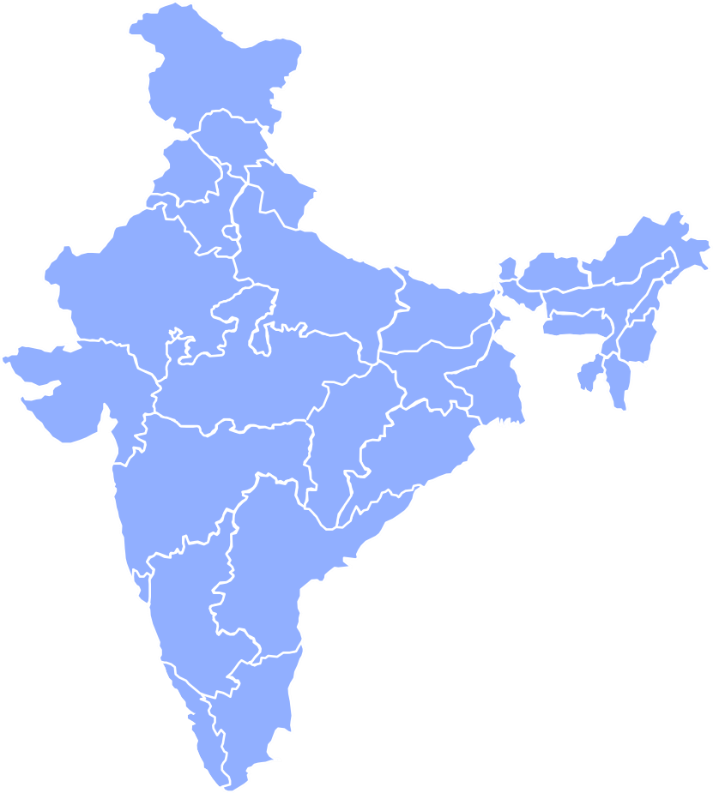
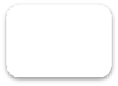



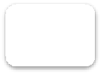

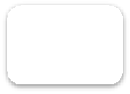
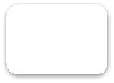





Of the total 3,402 product companies, approximately 51 percent are based in Bangalore and NCR region
Region | Cities
Bangalore | Bangalore, Mysore, Belgaum, Gulbarga, Hubli
Hyderabad | Hyderabad, Secundrabad,Vishakhapa tnu m,Vijayawada
Pune | Pune
Chennai | Chennai, Calicut, Trivandrum, Madurai, Coimbatore, Cochin, Vellore
Mumbai | Mumbai, Goa, Ahmedabad, Vadodara, etc.
NCR | Delhi, Gurgaon, Noida, Chandigarh, Mohali
Kolkata | Kolkata, Patna, Bhubaneswa r
Product companies split across
regions
Kolkat a
12
81
0
NC R
1
NC
R
49
8
Mumba i
Mumbai
Pune
Hyderaba d
Bangalor e
Kolkat a
22
7
Pun e
92
9
Bangalor e
43
5
Hyderaba d
Total=
3402
38
2
Chenn
Note: The cities marked in bold are emerging Tier-II cities for product startups
ai
2

Slide 35



Obtaining funding has proved to be a challenge; however, this is changing as VC investments in this space are rising
VC Investments in India (2005 – 2011)
VC Investments by Industry Value – 2012
1200
240
210
900
1110
180
16
%
170
3
%
6
%
7
%
34
%
150
140
600
110
120
7
%
USD
million
950
9
%
94
876
8
%
3
%
7
%
700
300
60
508
475
44
268
0
0
Online Services Mobile VAS
Healthcare & Lifescience BFSI
Food and Beverages
Enterprise Software and Products IT Services and Others
Energy Education Others
2005 2006 2007 2008 2009 2010 2011
Deal Value Number of Deals
Source: Venture Intelligence; Zinnov Analysis
3

Slide 36




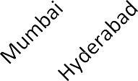

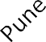
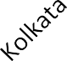
Overall 58 % of the funded companies from 2005 till today are from
Bangalore and NCR
VC Investments by companies Location
Funding timeframe for 2005-2012
(2005-2012)
companies
2/3rd of total
3/4th of total
Interestingly,
1/6th of startups
were funded in the year of inception
149
92
117
No of Companies
69
No of Companies
74
69
87
46
46
37
37
37
34
21
6
0
1
2
3
4
5
6
7
Locatio n
No of Years for
Overall funded companies from (2005-2012) are around 446 (i.e. 19 ^{f}%^{und}o^{i}f^{ng}2407 startups)
Around 66% of the companies obtained funding within 3 years of inception
• 69% of the companies which obtained funding during (2005-2012) are from Digital and Software
domain
4
Source of Funding: VCCircle, Crunchbase, Company Website, Zinnov Database and Secondary research.

Slide 37
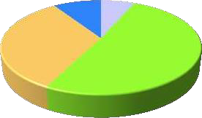


It is noticed that between 2009-12 more than 55% of the startup founders have less
than 10 years of experience
Startup Founder’s by Domain – (2009- 2012)
Founders
119
Tier 1
40
Enterprise Software | 196
Telecom | 72
BFSI | 25
Electrical & Electronics | 26
Semiconductors | 30
Others | 76
Overseas
44
9
%
7
%
33
%
51
%
Product Engineerin g | 178
Pure Services | 243
ITES | 118
Other | 114
Total = 1282
Fresher s
Service Provider
MNC
R&D
Serial Entrepreneurs
Startup Founder’s by Experience – (2009-2012)
Total = 1282
4/5th of total
393
Affinity to Startup is very high among people with
304
345
<15 years of
experience!
145
33
42
20
0-
5
6-
10
11-
15
16-20
Years of Experience
21-25
26-30
31
+
Source of Founder profiles: Linkedin, Company Website, Zinnov Database and Secondary research.
5

Slide 38
Software product management
Overview
BITS Pilani
Nandagopal Govindan

Slide 39
Contents
Evolution of product organizations
Why products fail?
What do best product teams do?
Product management: Relationship with rest of the company
Product Lifecycle
Technology adoption lifecycle
Journey of some product companies
Multi-faceted role of a Product manager

Slide 40
Evolution of product organizations
A product organization goes through the following stages:
Startup
Growth stage
Enterprise
Let us see what are the characteristics of each stage…

Slide 41
Startup stage
Trying to achieve product-market fit,
Limited funding,
Learns quickly
Little bureaucracy,
Many fail,
Those that succeed are good at product discovery,
Risky but rewarding if things go well.
Examples: WhiteHat Jr, Simpl

Slide 42
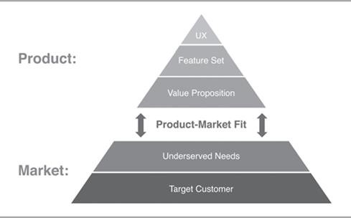
Product-Market fit concept

Slide 43


Startup stage examples
WhiteHat Jr
Founded in 2018
Offers coding & AI courses to children aged 6 to 14 years.
Aims to empower children to become creators
BYJU‘s acquired it for $300 million
Simpl
Started 2016
Online payment method that allows a consumer to buy now and pay later
Digitalizing the old Khata system of payment to grocer, milkman, etc.
Simpl under-writes customer payments based on machine learning
USP: Transparent financial services and single click payment

Slide 44
Growth stage
Scale up – more customers
Replicate earlier successes with new, adjacent products and services – MakeMyTrip flight, train, hotel
Technology infrastructure is stretched (Netflix during the growth stage)
There is technical debt (Amazon monolithic to microservices)
Goes for IPO or gets sold (MakeMyTrip IPO, WhatsApp sold to Facebook)
Examples: Bounce (2016), Postman (2014), KissFlow (2013).

Slide 45
Growth stage example
Kissflow
Business Process management software
Self-service setup / configuration
50 process templates to choose from – employee on-boarding, travel
reimbursement
Strong after sales support
Product led growth - leading to pull rather than push
10,000-plus clients, including biggies like Airbus, Danone, Michelin and
Pepsi
Competitors - Pega, Appian, Outsystems
200 employees

Slide 46
Enterprise stage
Focus is on consistent product innovation, stay ahead
But many companies are satisfied with leveraging the value created and brand created, leading to slow death (ex. Kodak)
They work hard to protect what they have created and less on new
ventures & initiatives
There is lack of vision, increased bureaucracy, resorts to acquisitions or creating separate innovation centers to incubate new business or products (example Cisco).
Companies that failed to innovate: Xerox, AoL, Motorola
Strong enterprise companies: Adobe, Amazon, Apple, Facebook, Google, and Netflix

Slide 47



Enterprise stage: Examples of consistent innovation
Netflix | Amazon | Facebook
DVD movie sales DVD rentals Online booking of DVD, delivered via Post Streaming video In house production of serials and movies Movie / Serial Award function (akin to Oscar) | Books Electronics, Others Recommendation feature Amazon Prime Alexa Kindle AWS Firestick Amazon Pay | Wall & messaging News Feed - streams friend’s activity Sell stuff to other Facebookers Tagging and attachments ‘Like’ button Timeline feature Buys Instagram, WhatsApp

Slide 48
Why products fail?
Most companies start with ideas generated internally or got from existing
or potential customers.
Example: HP’s AI‐enabling technology on a low‐cost, general‐purpose workstation developed by Marty Cagan & team (1980s), DB designer – I worked on (1989)
Based on these ideas they create a business case, roadmap, build the product and deploy
It is then that they realize that there are no takers
More examples of failed products:
Apple Watch Gold edition
Google+ social media
The Daily - Digital newspaper in collaboration with Apple

Slide 49
What do best product teams do?
Tackle risks early
Define and design products collaboratively – PM, Designer, Engineering
Solve problems, not just implement features

Slide 50
Tackle risks early
There are 4 types of risks:
Value – Does customer find value in the product
Usability – Is the product easy to use
Feasibility – Is the product techically feasible to build
Viability - Will be business be viable, can we break even

Slide 51
Tackle risks early - Example
Bounce, AirBnB, Slack
Bounce spotted an opportunity in Bangalore: Provide scooter to reach the nearest metro station
Bounce experimented their concept with a few scooters to determine
value. Once the demand / value was established, they expanded
AirBnB rented their house to test value. A conference was being held in
their city and people would be looking for accommodation
Slack requested friends and cajoled 6-10 companies, to use their product and give feedback to determine usefulness / value and usability and improved the product based on user feedback.

Slide 52
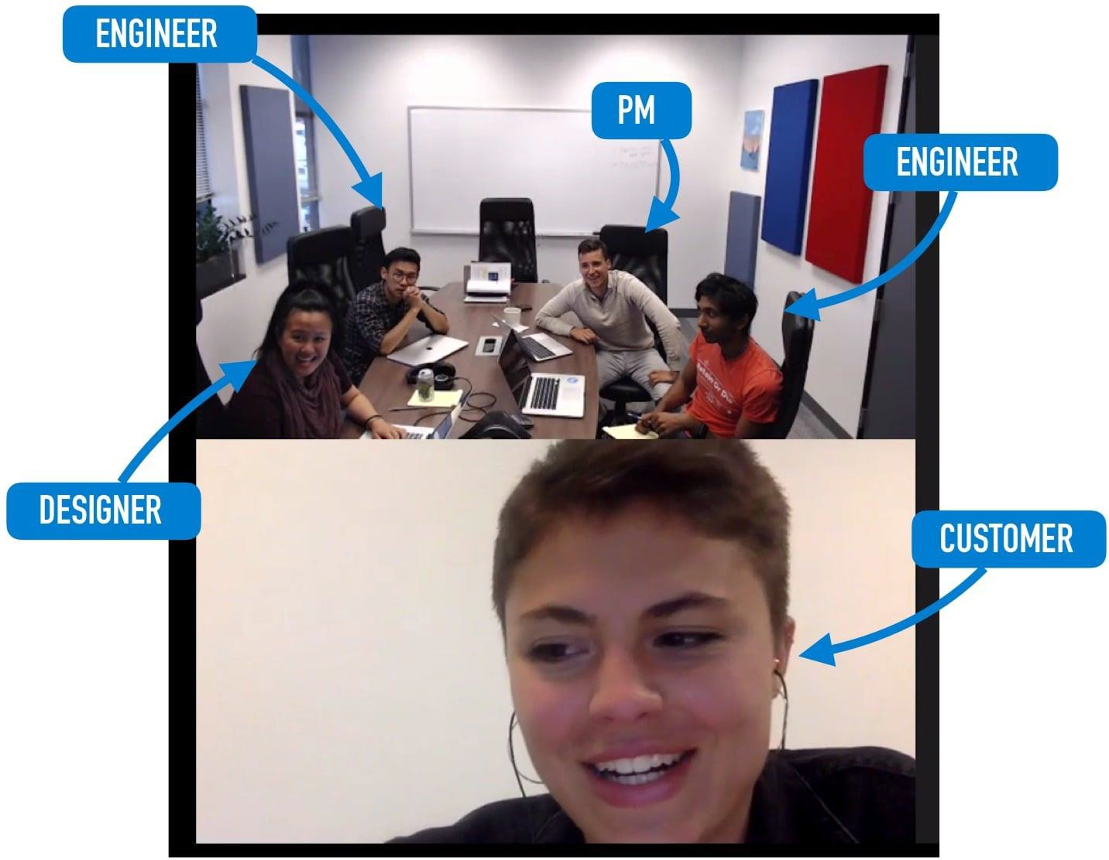
Define and design products collaboratively
Product, design & engineering work side by side in a give-and-take manner
Leads to better solution ideas & higher ownership
Example: Amplitude
A product analytics s/w
Engineers stay connected with customers by participating in client calls

Slide 53
Solve problems, not just implement features
Example: Kissflow
Workflow automation improves employee productivity
Provides 50 ready-to-use workflows from travel reimbursements to
employee on-boarding
Easy diagramming helps model a company’s process just as it appears in the business manager’s mind.

Slide 54
Solve problems, not just implement features
Example: Wobot Intelligence
Helps organizations in the Food, Retail, and Manufacturing sectors to reduce risk of non-compliance & pilferage
Has process compliance modules like hygiene, workforce & workplace
safety, customer SOPs, and more
Uses deep learning Video Analytics to identify people, objects and their activities
Customers - IRCTC, Rebel Foods, CureFit, Kitopi, Travel Food Services, Burger Singh, G4S, Max Estates, Blue Tokai, Apparel Group and Smartworks

Slide 55
Solve problems, not just implement features - Example
Example: Logically
Detects fake news & inaccurate news using AI & ML
Finds out who is spreading misinformation to enable authorities to take
action
Examples:
Detected misinformation during the death of a Bollywood actor Sushant Singh, during conflict with China in Ladakh, and during the Kashmir issue with Pakistan.
Detected bots originating in Pakistan that were interfering with geopolitical and sensitive issues within India
Customers: Indian Election Commission, Pharma companies to prevent anti-vaccine information, Mysore Police

Slide 56
Product management: Relationship with rest of the company
Development team relies on product management to define a plan and
write user stories, requirements, and acceptance
Marketing team relies on Product management for product information, value proposition definitions. They collaborate to define product position, launch product, define Go-to-market strategy
Sales team relies on Product management for demo cases, answering detailed inquiries, and helping to close deals.
Finance and Product rely on each other to build the business through
determining pricing, margins, discounting, and so forth.

Slide 57
Product lifecycle
Determine your target customers
Identify underserved customer needs
Define your Value Proposition
Assess value through customer interaction
Specify your Minimum Viable Product (MVP)
Create your MVP prototype
Test your MVP with customers
Iterate
Launch product & support
Grow & build adjacent products
End of life

Slide 58
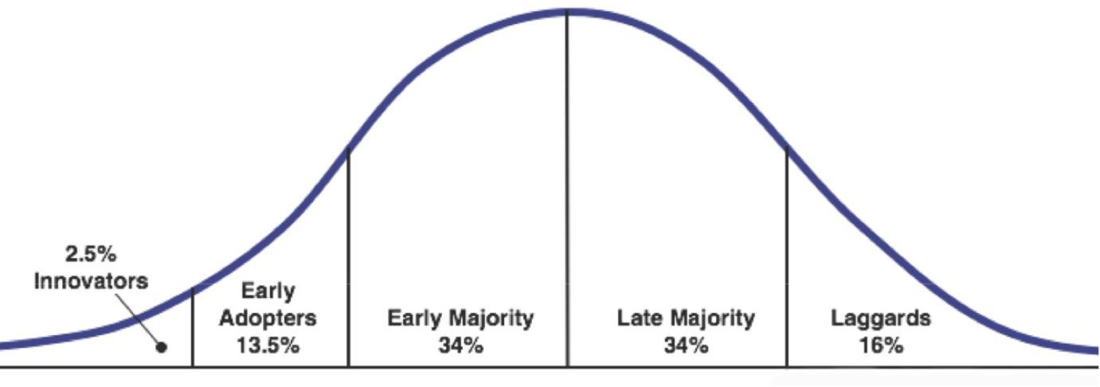
Technology adoption lifecycle
Products using new technology such as AI, NLP, Blockchain, Robotics are
adopted gradually

Slide 59
Technology adoption lifecycle…
Innovators are the first to get interested on new products and novelties. They even accept incomplete or defective products just for the pleasure of being the first ones to use this new product.
Early adopters, also known as visionaries or enthusiasts, who accept the risks of testing a new product, but not for the pleasure of coming first but because they see the potential in it. Usually, they are influencers within organizations and communities in which they participate.
IBM Watson was adopted by a Memorial Sloan–Kettering Cancer Center, Cleaveland Clinic, MD Andersen Cancer Center, to get advise on Cancer
Early majority, also called pragmatic, buy new products only after they got
references.
Manipal Hospital Bangalore, Georgia tech teaching assistant, H&R Block for tax preparation, Several startups use it for developing cognitive apps
Late majority are the conservatives, in other words, those who buy only after the
price has dropped substantially. Example late majority users of SalesForce
Laggards, who only buy a new product if this is the only option available.

Slide 60
Technology adoption lifecycle…
Example:
IBM Watson & Robotic surgery (Da Vinci) used by one or 2 hospitals.
In 1999 Salesforce.com was the first to use Cloud to offer applications on the Cloud. 3 years later the industry grew massively with video, music and other media being hosted and delivered online.
https://www.scality.com/solved/the-history-of-cloud-computing/

Slide 61
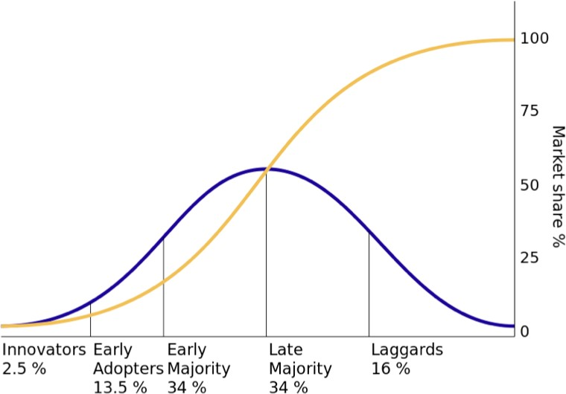
Technology adoption lifecycle…
S-curve: By calculating the integral (who remembers the calculus classes?)
we can obtain the famous S-shaped technology adoption curve.

Slide 62
Multi-faceted role of a Product manager
Deep knowledge of customer, your business, market & industry
Nium - money transfer to foreign countries
Had deep knowledge of money transfer markets in Singapore,, Indonesia, Japan, etc.
Had good knowledge of forex – how it works, who are the players, banking
Engage with customers, understand their business, process, pain points
Slack understood the collaboration needs of teams
Twilio understood the messaging needs of companies
Wobot understood the process compliance needs of food, pharma, retail
industries
Prioritize ideas, features & projects
Slack focused on Search, synchronization, file sharing
Collaborate with Design, Engineering, Marketing, Legal, Finance
Recruit, Train & develop the product team
Manage upward & outward: Tell a story, sell a vision, get funcding
Align & focus the organization

Slide 63
Journey of some product companies: Exercise
Study the journey of Netflix and identify:
Key milestones
Challenges faced
What they did right and what they did wrong
Key Product management learnings
Courtesy: https://www.businessmodelsinc.com/exponential-business- model/netflix/

Slide 64
Appendix

Slide 65
Software product management
Core concepts
BITS Pilani
Nandagopal Govindan

Slide 66
Contents
Principles of product management
Characteristics of a holistic product
Product-Market fit
Problem space vs Solution space
User vs buyer
Continuous discovery and delivery
Product eco-system
Critical success factors

Slide 67
Principles of product management
Establish compelling value. Examples:
MakeMyTrip – a one stop shop for travel,
Postman – Make API testing easy
Many of our ideas won't work out, and the ones that do will require several
iterations. Examples:
Slack - Initially they developed a multi-player online game which did not succeed, but the inbuilt messaging feature became successful.
MakeMyTrip initially targeted Indian travellers, but was not successful. Later targeted NRIs
We must validate our ideas on real users and customers. Examples:
Bounce – Validated the ‘Rent-a-bike’ idea by investing in a few scooters
AirBnB – Rented their apartment to conference attendees
Validate ideas fast and with minimal cost – the more we delay, we may be
expending more effort & cost on an idea that does not have a market.
Have you experienced any of these principles?

Slide 68
Different aspects of a product
Functionality: Example booking tickets is one function of MakeMyTrip
Technology: Example: Microservices architecture used by Amazon, Encryption used by WhatsApp, AI/ML used by Logically
User experience: (UX): Example Tally’s ease of use for non-finance
people
How do we monetize?: Example through transaction fee of Payment gateways or subscription fee of SalesForce
How we attract & acquire customers? Example: Freemium of Zoom, cash
back of Paytm, Search Engine Optimization, Ads
Offline experience: Example: Merchandise fulfilment experience and merchandise return experience of Amazon & FlipKart, support experience by call center personnel, self help material on website

Slide 69

Product-Market fit
It is about how well the product meets the needs of the customer (market)
Good Product/market fit results in happier customers, lower churn rates, shortened sales cycles, and rapid organic growth. (Inspired)
You can always feel when product/market fit isn't happening. The customers aren't quite getting value out of the product, word of mouth isn't spreading, usage isn't growing that fast, press reviews are kind of "blah", the sales cycle takes too long, and lots of deals never close.

Slide 70
Product-Market fit
Marc Andreessen coined the term product-market fit in a well-known blog post titled “The only thing that matters.” (https://pmarchive.com/guide_to_startups_part4.html)
In a great market -- a market with lots of real potential customers -- the
market pulls product out of the startup. Example
eCommerce, EdTech, FinTech
Conversely, in a terrible market, you can have the best product in the world and an absolutely killer team, and it doesn't matter -- you're going to fail. Example:
Video conferencing (2007), Iridium satellite phone
Do you know of any great product that failed?
Great products sometimes create huge new markets – examples:
Virtual machine by VMWare, smart phone by Apple
Any other?
The only thing that matters is getting to product/market fit.

Slide 71
Problem space vs Solution space
Problem space consists of customer needs and pain points.
However problems are not always easy to know:
Customers express their needs in terms of existing solutions.
For example they say “I need a cab in 5 minutes”, because they think cab is the only solution
The real need is to go from A to B.
There can be many solutions for this:
Hire a cab,
Use self-driving scooter or car,
Hail a bike taxi.
Any other?
Therefore before finding a solution, we need to understand the real need / problem
Understand what customer needs and why
Observe what he does, why he does it, etc. (Persona)
“If I had only one hour to solve a problem, I would spend up to two-thirds of that hour in attempting to define what the problem is.”

Slide 72
Problem space vs Solution space…
What differentiates one product from another is the quality of solution. Examples:
Space pen: Need is to write in space. US designed an ink pen that works in zero gravity. Russians used a simple pencil
Progressive auto insurance: Customer wanted quick settlement of car insurance claim. A process that took 6-7 days was cut down to 1 day through innovative solution
MoveWorks: Users need quick IT support to install say a Project management software. Solutions can be: Raise a ticket, Call IT support, Use MoveWorks bot which will check your eligibility and download the sw & install it instantly
Application maintenance service: Is faster problem resolution the need or zero problem the need
Any other example?

Slide 73

Problem space vs Solution space: Case study
Rivigo case
What did the founders do to discover the problem?
What was the real problem?
How did they solve the problem?

Slide 74
User vs Buyer
In large enterprises the decision makers are not the end users
Decision makers are usually VP and SVP. They want to solve a business problem / pain point.
Their concerns are functionality that brings business value (increase customer satisfaction, customer growth, reduce customer churn), productivity, security, reliability / stability / quality of solution
The end users typically do not have the power to approve the product. But ultimately they are the ones who are going to use the product. Hence it needs to be user friendly, efficient in performing their functions.
Example
Lotus Notes: It was a very secure team database and Email system. But not very user-friendly.
Cisco WebEx – very reliable but not very user friendly. But corporates prefer it.
Do you know of any other examples?
But this is changing with SaaS product. Management is becoming more aware of UI / UX

Slide 75
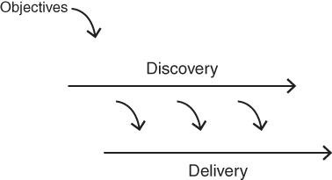
Continuous discovery and delivery
Discovery and delivery are our two main activities on a cross‐functional product
team, and they are both typically ongoing and in parallel.
We are always working in parallel - to both discover the necessary product to be built—which is primarily what the product manager and designer work on every day—while the engineers work to deliver production‐quality product.
The engineers are also helping daily in discovery (and many of the best innovations come from that participation, so this is not a minor point), and the product manager and designer are also helping daily on delivery (mainly to clarify intended behavior). But this is what's going on at a high level.
Example Postman, Slack
Does this happen in your product company?

Slide 76
Product eco-system
Product should address the total customer experience (the whole offer)
Kaagaz & MS Office Lens (document scanner app on mobile) does not only scan but allows us to share the image via email, WhatsApp etc. Because the customer is not just interested in scanning and storing, he wants to share with others
Xerox started with photo copying facility but soon realized people need to staple the pages, need cover page in different colour, etc. So they enhanced the machine to address the total customer experience
Clarify: customer support software that involves tracking customer interaction,
product details, knowledge base, workflows
No Broker.com: Find house, pay advance, get painter, get packer & mover
Have you come across other products that address total customer experience?

Slide 77
Product eco-system
Creating Partnerships & alliances
Xerox tied up with paper manufacturers to ensure steady supply of paper
SAP partners: DataXtream for POS solutions, DocuSign for eSignature
integration with SAP
Netflix tied up with telecom service providers such as Verizon, Airtel to host their content at ISP gateways, so as to ensure fast response time to customers
MakeMyTrip built alliances with Airlines, hotels, etc.
Any other examples you have come across?

Slide 78
Critical success factors
Differentiation
Intuit – UI and features
Apple – UX
Citibank– Reliability & infrastructure
.Net – Ease of use
Toyota – Quality
ISRO – low cost satellite launches for world-wide customers –
Entry barrier
Google Earth – Entry barrier due to technology
Da Vinci Robotic surgery – Technology
Microsoft HoloLens – Mixed reality technology for doctors, etc

Slide 79


Case study
Twilio & Byju’s
What concepts are illustrated by these cases?

Slide 80
Case study…
User vs Buyer, Continuous discovery, Critical success factors, Customer
acquisition
Twilio
User vs Buyer: Developer vs Org,
Continuous discovery & delivery: SMS, email, Call center,
Critical success factors: easy to use, even finance person can code this
Byju’s
User vs Buyer: Child vs parent
Customer acquisition - freemium model
Critical success factor:
Focus on learning to think rather than spoon feeding
Making it interesting and making children addictive

Slide 81
Appendix

Slide 82
Software product management
Product process: Identify opportunity
Nandagopal Govindan
BITS Pilani

Slide 83
Contents
Overview of product process
Identifying opportunity

Slide 84
Overview of product process
Identify opportunity
Assess the opportunity
Create business plan
Specify product features
Specify Minimum Viable Product (MVP) feature set
Test your MVP
Iterate & Pivot to improve product-market fit

Slide 85
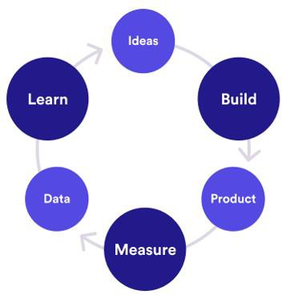

Build-Measure-Learn cycle
Customer interviews
Root cause analysis
Agile
Continuous integration
Minimize total time through the loop
# Visits, conversion, retention
How many use new feature?

Slide 86
Identify opportunity
Identify underserved customer needs (LPP)
Sources of innovation (Peter Drucker)
Hack days (Inspired)
Ideation techniques (Cooper & Edgett) (SPM book)
Case study: DBS Bank
Case study: Innovation ideas from ID Foods - Mustafa

Slide 87
Identifying underserved needs
Observe
Experience
Fortune at the bottom of the Pyramid – CK Prahlad
Desire to do social good can find new opportunities

Slide 88
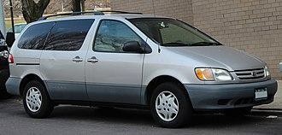
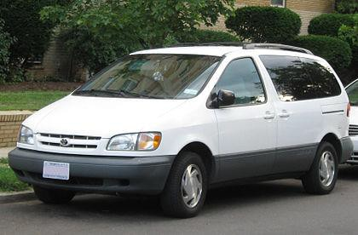
Observe
Toyota Sienna
The car was successful in Japan
Toyota wanted to understand the specific needs of US market
A senior manager spent several months driving 70,000 miles across length & breadth of US observing how people use cars
In US children sit in the backside of the mini van
So changes were made to make the back seats more comfortable,
safe, etc.
When it was launched the car became a big hit

Slide 89
Observe
Oyo: Economy hotels were not clean, lacked basic amenities, etc.
Sketch: Observed that Photoshop was not easy to use
Slack: Collaboration between teams was clumsy
Spotify: People wanted to listen to music legally when illegal music
sharing sites were banned

Slide 90
Experience
Ola cabs: Founder was travelling in a cab and cab driver demanded
exorbitant amount to change the destination
DropBox: Founder kept forgetting to carry files in pen drive
Tally: Experienced that existing accounting packages had a User interface that catered to accounts / finance professional. But not to non-finance folks

Slide 91
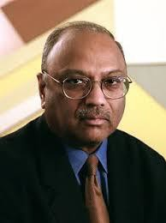
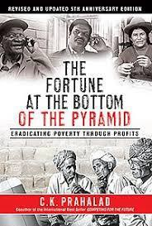
Opportunities are in plenty at the bottom of the Pyramid
Opportunities are aplenty if look at the right market
CK Prahlad wrote a book ‘Fortune at the bottom of the Pyramid’
Large business tend to target the middle class and upper middle class
However there is a huge market at the bottom of the pyramid of society
They need products but can not afford high price
If the products are priced right, there is a big opportunity
Examples:
Shampoo sachet for Re.1
Micro credits to rural people to buy a sewing machine, a cow to start milk business, etc. It was observed that default by rural people is significantly less compared to urban people because of the fear of o
Jio, Nirma are other examples of targeting the bottom of the pyramid

Slide 92
Desire to do social good can find new opportunities
(Social entrepreneurship)
Grameen Bank: Mohammad Yunus helped poor to stand on their own legs
through micro-businesses
Aravind Eye Hospitals: Free eye surgery for poor, funded by rich patients, developing low cost intraocular lenses
Narayana Hrudalaya: Dr Devi Shetty offeres low-priced heart surgeries by
employing efficient operation procedures, low cost insurance schemes
Selco: Dr. Harish Hande developed solar lamps to helps silk farmers harvest mulberry leaves which needs to be done during cooler hours – late evening or early morining
Rivigo: Helped truck drivers lead a stigma free life through relay based
truck logistics
Apna: Developed an app for finding blue collar jobs such as delivery boys

Slide 93

Case study: Qalara
What was the opportunity identified by Qalara?
How did Qalara identify the opportunity?

Slide 94
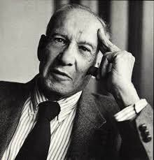

Sources of Innovation: Peter Drucker
Father of management &
A Social scientist

Slide 95
Sources of Innovation: Peter Drucker
Drucker argues that most innovative business ideas come from methodically
analyzing seven areas of opportunity
Some of which lie within particular companies or industries
Some of which lie in broader social or demographic trends.
Astute managers will ensure that their organizations maintain a clear focus on all seven

Slide 96
Sources of innovation: Peter Drucker
Unexpected occurrence
Incongruities (incompatibilities)
Process needs
Industry & market changes
Demographic changes
Change in perception
New knowledge

Slide 97
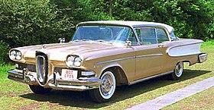
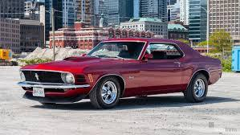
Sources of innovation: Peter Drucker
Unexpected occurrence
IBM developed accounting machines in 1930s. Banks did not have money to buy. But libraries had money and they bought 100 machines
Ford Edsel was very carefully designed. But people bought cars for
lifestyle. This resulted in newer models like Mustang

Slide 98
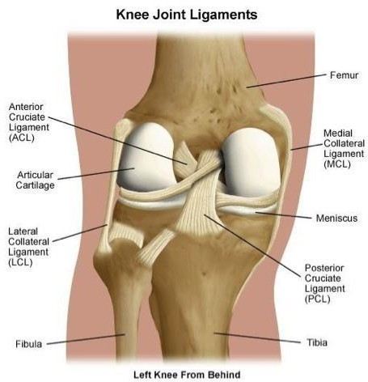
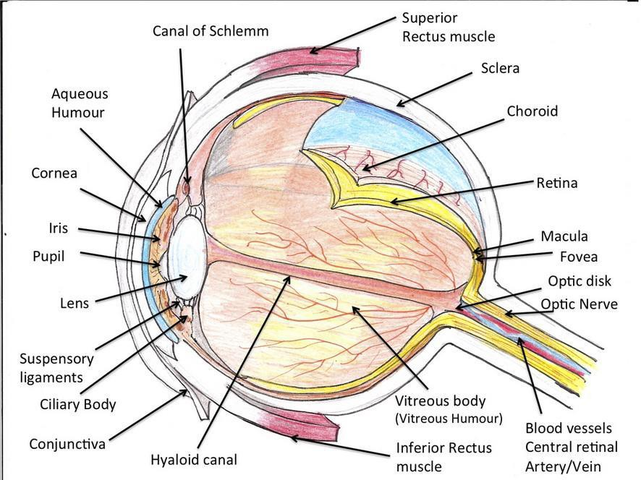
Sources of innovation: Peter Drucker
Incongruities (incompatibilities)
– Cataract operation: Cutting eye ligament is difficult. Instead used enzyme to dissolve ligament

Slide 99
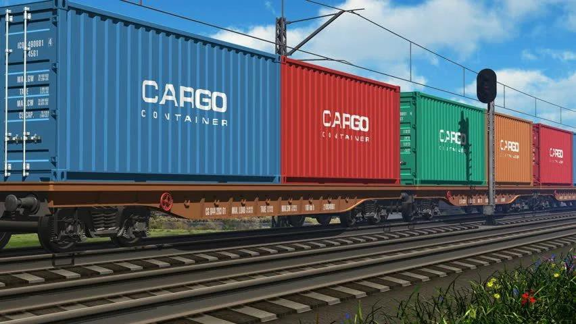
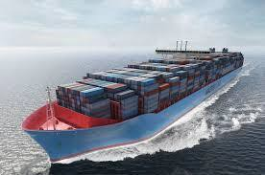
Sources of innovation: Peter Drucker
Incongruities (incompatibilities)
– Shipping industry trying to improve speed and fuel efficiency. But problem was time wasted at ports to load & unload. Adopted containers used in railroad and trucks

Slide 100
Sources of innovation: Peter Drucker
Process needs
Newspapers needed a faster way to print. This resulted in Linotype machine
Those days newspapers did not make much money. So they invented advertisements and kept the cost to customer low
Industry & market changes
Retail industry changes: E-Commerce
Banking changes: Payment banks

Slide 101
Sources of innovation…
Demographic changes
1970s saw baby bust and education explosion. This led to shortage of workers. Japan created Robots
Affluent educated young people wanted a different kind of holiday. This led to resort business
Change in perception
In spite of fall in mortality rates, Americans were concerned about cancer, heart disease, etc. This led to health mags, gym, healthy foods
New knowledge
Computers
Etc.

Slide 102
Principles of Innovation – Peter Drucker
Go out, look, ask, listen, because innovation is conceptual & perceptual
Keep innovation simple and focused. Else people get confused
Start small: Example putting the same number of match sticks into a matchbox (it used to be 50), gave Swedes a world monopoly for half a century
Aim at leadership from the beginning, else it is unlikely to be innovative enough
Innovation requires knowledge, ingenuity, and, above all else, focus. Edison worked in electric field only. Citibank did not venture into health care
If diligence (careful), persistence, and commitment are lacking, talent, ingenuity, and knowledge are of no avail. Like in any other endeavour

Slide 103
Identify opportunities…
Annual Idea generation by Bill Gates
2 weeks shut out from world
Go through ideas submitted by employees
Hack days (Inspired)
Hack days – directed and undirected.
Eg of directed hack day with a theme – reduce customer churn, increase life
time value (Inspired)

Slide 104
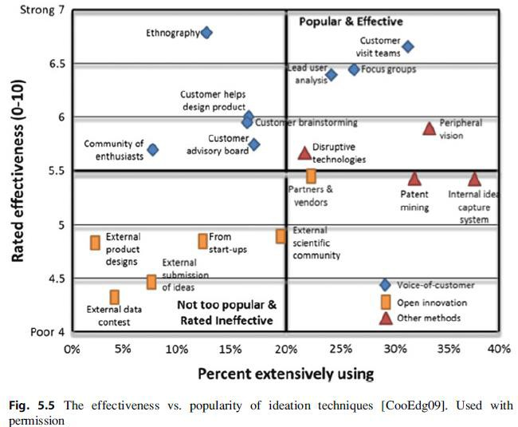
Ideation techniques (Cooper & Edgett)

Slide 105

Case study: DBS
Are you really innovating around customer needs? – HBR
What is the assumed need & real need of the customer of DBS?
How did DBS satisfy that need?

Slide 106

Case study: ID Fresh Foods
Innovation ideas from ID Fresh Foods – PC Musthafa
What innovation lessons can we learn from ID Fresh Foods?
Fresh & preservative free is possible
Packaging innovation – Vada
Marketing innovation: Trust shops

Slide 107
Exercise
Consider your current job & company
Think about the unmet / underserved needs of your customers
Give one example of such a need & its compelling value / benefit to
customer.

Slide 108
Appendix

Slide 109
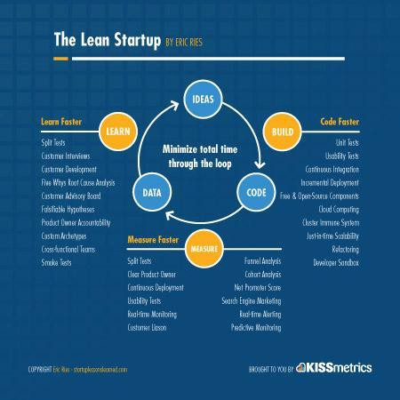

Slide 110
Software product management
Assess opportunity
Nandagopal Govindan
BITS Pilani

Slide 111
Contents
Define value proposition
Assess value of the product
Assess the risks

Slide 112
Define value proposition
Steps:
Define Customer problem / pain point
Ex. Difficult to reach Metro station (Bounce)
Explain how your product solves customer problems or improves their situation (relevancy)
Ex. Rent a bike – pickup near your house & drop anywhere (Bounce)
Determine a specific set of benefits it delivers, preferably quantifiable (Value)
Ex. Easy to reach Metro station. Saves 30 minutes.
Explain why the customer should buy your product instead of the
competition’s (Differentiation)
Ex. More convenient than walking to bus stop, then taking a bus and then once again walk to the Metro station

Slide 113
Define value: Examples
Product | Pain point | How does it solve | Benefit / Value prop. | Differentiation from competition
Bounce | Difficult to reach Metro station | Provide bike on rent – pickup & drop anywhere | Easy to reach Metro station | More convenient than bus
AirBnB | Unable to get a feel for the city & its people & culture | Rent room in a house instead of hotel | Get unique experience of local culture | Hotels do not provide this experience
Zoom | Poor video quality | Better technology | Superior experience | Superior quality compared to WebEx

Slide 114
Define value: Exercise
Product
Pain point
How does it solve
Benefit / Value prop.
Differentiation from competition
Rivigo
OYO
Postman

Slide 115
Assess value of the product
Talk to potential customers to assess the opportunity
This is one of the most powerful and important skills for any product manager and very often the source or inspiration for many breakthrough product ideas.
Through interview, understand
Are your customers who you think they are?
Do they really have the problems you think they have?
How does the customer solve this problem today?
What would be required for them to switch?

Slide 116
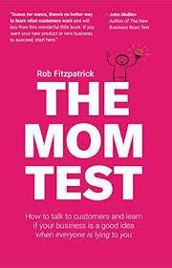

Interview customer: Example
‘Mom Test’: How to ask the right questions to assess a product idea?

Slide 117
Mom Test: Part 1
What wrong questions were asked?
Asking close ended question “You like your iPad right?” instead of “How often do you use the iPad?” or “What do you use your iPad for?”
Asking whether you will buy the product without first explaining the product: “”Would you ever buy an app which was like a cookbook for your iPad?”
Telling the features without first trying to understand what features are needed “you can share recipes with your friends, and there’s an iPhone app which is your shopping list. And videos of that celebrity chef you love”.

Slide 118
Mom test: Part 2
Did Mom have a need for recipe book on iPad?
Probably for healthy dishes
What market segments could be were discovered from the conversation?
Young people
What kind of recipe books could be targeted to young people?
Basic dishes
What is good about this question: “What’s the last cookbook you did buy for yourself?”

Slide 119
Tips for customer interview
Go with intention to learn – Ask about their work, how they do it
Meet customer in their location – This will make them comfortable
Go with Product manager, UX designer and engineer – to brainstorm later
Do the customer's job for them, to understand the problem

Slide 120
Insight to be gathered during opportunity assessment:
Do consumers have the problem you are trying to solve? – Is our
hypothesis true?
If there was a solution, would they buy it? – Is the need compelling?
Would they buy it from us? - Are we better than competition?

Slide 121
Also try to signup pilot customers, during this phase
Identify 6 customers who truly feel the pain and are near desperate for the solution we plan to build, who are willing to test the product and buy it once ready and willing to be reference.
If you are unable to find even 4 or 5, then we are probably chasing a problem that is not very important.
It is important to explain that you are trying to build a product useful to many customers and not a custom solution.
Explain that you will dive deep into the problem and build a single solution
that works well for all 6 customers.

Slide 122
Assess opportunity: Exercise
Design a set of interview questions to assess the following product idea
Online book library for students - technical & management books that allows student to borrow & read digital books (similar to Spotify) (B2C)
Pain point: Students need to refer to many books. But only some parts of the book are useful. Buying the whole book is not value for money
Solution:
Tie-up with publishers to make books available online
Students pay a monthly subscription
Students get to borrow 5 books at a time and read them online
Publishers gets commission based on books borrowed and the duration the book was used

Slide 123
Role play: Interview
Let us do a role play
Need 2 volunteers – Interviewer and Interviewee
Interviewer: Vinay Adaki, Shashank
Interviewee: Dewraj, Vinay
Let us observe the conversations and note down which questions were
good and which could have been better
Please note that if we were the interviewer, we might have fared in a similar way
This is only a learning exercise and not a test of your interview skills

Slide 124
Possible questions to ask the students…
What courses are your doing?
How many hours do you study every week?
What resources do you use to study?
How sufficient are these, for your study?
What kind of additional resources would help?

Slide 125
Assess opportunity: Exercise
Design a set of questions to validate the following product idea
Website to enable a company to identify the right software product to purchase for a given business need (B2B product)
Pain point: There are many products in same category. Companies find it hard to pick a right product for their needs such as logistics, workflow, payroll, sales, customer service
Solution:
Provide a directory of selected software products along with product details, product comparisons, business use cases they support, etc.
Provide phone consultancy to help clients select the right product for their need

Slide 126
Appendix

Slide 127

Software Product Management
Risk assessment
BITS Pilani
Nandagopal Govindan

Slide 128

Contents
Value risk
Usability risk
Feasibility risk (technical feasibility)
Business viability risk

Slide 129
Introduction
Key risks to be assessed are:
Will the customer buy this, or choose to use it? (Value risk)
Can the user figure out how to use it? (Usability risk)
Can we build it? (Feasibility risk)
Does this solution work for our business? (Business viability risk)

Slide 130
Test value
Good product teams spend most of their time on creating value. If
the value is there, we can fix everything else.
If value is not there, then it does not matter how good our usability,
reliability, or performance is.
Just because someone can use our product doesn't mean they will choose to use our product.

Slide 131
Test value
Identify 6 customers who truly feel the pain and are near desperate for the solution we plan to build, who are willing to test the product and buy it once ready and willing to be reference.
If you are unable to find even 4 or 5, then we are probably chasing
a problem that is not very important.
It is important to explain that you are trying to build a product
useful to many customers and not a custom solution.
Explain that you will dive deep into the problem and build a single solution that works well for all 6 customers.

Slide 132
Test Value
2 types of testing value
Qualitative
Quantitative

Slide 133
Qualitative testing
Qualitative testing is focused on the response, or reaction:
Do customers love this?
Will they pay for it?
Will users choose to use this?
And most important, if not, why not?
Are they willing to recommend?
Are they willing to spend significant time to work with you to
develop the product
Any other?

Slide 134
Quantitative testing
Techniques to do quantitative testing:
Landing page technique (also called Fake door)
Crowd funding technique
A/B testing for features
Use pre-selected / agreed customers who have agreed to be partners / to discover the product – how many of those want it
Any other?

Slide 135
Test Usability: How?
Get sample users to test. Tell them it is just a prototype of an early product idea, request for honest feedback
See if they can tell from the landing page what the product is
meant for
Observe if users can easily do the tasks
Identify places where the model presented by the software (design model) does not match with how the user is thinking (mental model)
For example, a user clicked on a button and you are not sure why he did it (these need to be fixed in next iteration)
Wrap up by asking:
Which features were valuable? (value)
How easy to use was the product? (usability)
How likely are you to buy the product? (value)
Experience sharing….

Slide 136
Test feasibility
(Technical feasibility)
This is needed when we need to use new technologies like AI /
ML, Robotics, Augmented reality
Getting the engineer's perspective earlier also tends to improve the solution itself, and it's critical for shared learning
Example: There can be multiple ways to solve the problem of preventing leakage of confidential company data
Check when data is being sent out: High on safety, low on
performance, low on deployment
Check after data is being sent out: Low on safety, High on performance, high on deployment
Which solution is better is for the business to decide
Experience sharing…

Slide 137
Test business viability
Business aspects to be considered:
Marketing
Sales
Customer service
Finance
Legal

Slide 138
Marketing
Your product must fit within the brand (image) promise of your company's
other offerings.
HSBC PayMe Moble app example:
HSBC bank is known for high quality customer service.
They planned to introduce a Mobile app PayMe which should have highest quality of UX, performance and security.
It can not have afford to have a login feature, where the user logins with Facebook user id / password or Google user id / password, even though this may be good enough.
The perception created will be that the bank is compromising on security by depending on external entities such as Facebook

Slide 139
Marketing…
Your product must fit within the brand (image) promise of your
company's other offerings.
IBM Mainframe example:
IBM is known for highly reliable products and high customer
service.
Once a customer’s mainframe crashed
An engineer flew from Bombay to Delhi with a small part to fix a
mainframe, because it was mission critical for the org.
If the new product idea is not backed up by a solid customer support plan, it will not fit in the brand promise of IBM

Slide 140
Sales
Do the sales people / channels have the skills to sell the product?
Our sales people may be familiar with selling business oriented products such as Payroll, Customer support or Expense process.
Now if we are introducing a tech oriented product for detecting autism using AI that analyses videos of patients who have autism (CogniAble), then the sales staff may not have the skills to handle this product and we need to have a plan to address this.
If we are used to sell product a B2C via channel partners and now we are planning to do direct sales because it is a B2B product, then our sales people may not be able to handle this.

Slide 141
Customer service
Do we need a high touch customer service model or low touch?
Twilio offers simple API such as: Dial, Play, Disconnect
Open API of banks: This may require a high level of support
since it involves money

Slide 142
Finance
The costs to produce, market and sell your product must be sufficiently less than the revenue your product generates. What is the RoI, break even?
Let us say we are going to spend 100 on building, marketing and selling and recurring operational costs are negligible (hypothetical)
If the cost of the product is 1 and sales per month is 2 copy, then it will take 4 years to recover the cost. The break-even period is 4 years
RoI in 10 years is 240 (10 years * 24 copies per year * 1) - 100
= 140
Experience sharing…

Slide 143
Legal
Are there any Privacy concerns, compliance concerns, intellectual
property, and competitive issues
Privacy & Compliance:
EU data should be stored in EU data centers only
HIPAA compliance for health records related data
SOX
GDPR
Intellectual property
Are we using any IP without purchasing them – eg.
Samsung, Nokia, Apple
Open source software licence usage: what can be distributed freely
GNU General Public License (GPL)
Apache license
Experience sharing….

Slide 144
Exercise: Risk identification and mitigation
Vedicure is a medical device company that wants to develop a device
(hardware + software) to cure fever, stomach pain, headache, etc.
The device produces sound waves (vibrations) based on Vedic mantras, which has a positive effect on the patient.
You are a mentor to the product team. What prominent risks do you see & what mitigation approach would you suggest?
Answer:
Feasibility risk – Create a PoC
Marketing risk (acceptance by market may be a challenge) – Get Vedic scholars like Baba Ramdev, to endorse the product

Slide 145
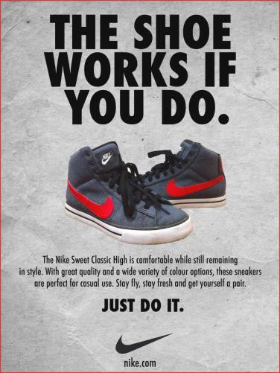
Exercise: Risk identification and mitigation
Ad-creator is a software that creates an ad based on product,
its value and the target segment.
The ad consists of heading, description text and a picture.
This ad can then be published in newspapers.
You are an Angel investor. What prominent risks do you see & what mitigation approach would you suggest?
Answer:
Feasibility – Create PoC
Marketing risk – Sign up high profile pilot customers

Slide 146
Khata-book is a product that maintains the purchases you make at your local kirana (small grocery) store and you can make payment at the end of the month.
Target market is Kirana stores and customers (who will have to approve
the purchase)
You are a product consultant. What prominent risks do you see & what mitigation approach would you suggest?
Answer:
Value risk – Speak to 50 kirana stores and 1000 customers to assess value
Usability risk – since users are kirana store owners & lay people. Do usability testing with sample users

Slide 147
Experience sharing…
How did you address the risks in your product solution?

Slide 148
Appendix

Slide 149
Software Product Management
Create business plan – Lean
Canvas
BITS Pilani
Nandagopal Govindan

Slide 150
Contents

Slide 151
Introduction
Once we have assessed an opportunity, it is good to put all our
thoughts together on paper.
A detailed business plan covering – problem, solution. USP,
market size, revenue generation, etc. needs to be created
A simpler 1-page plan can be created for quick understanding

Slide 152
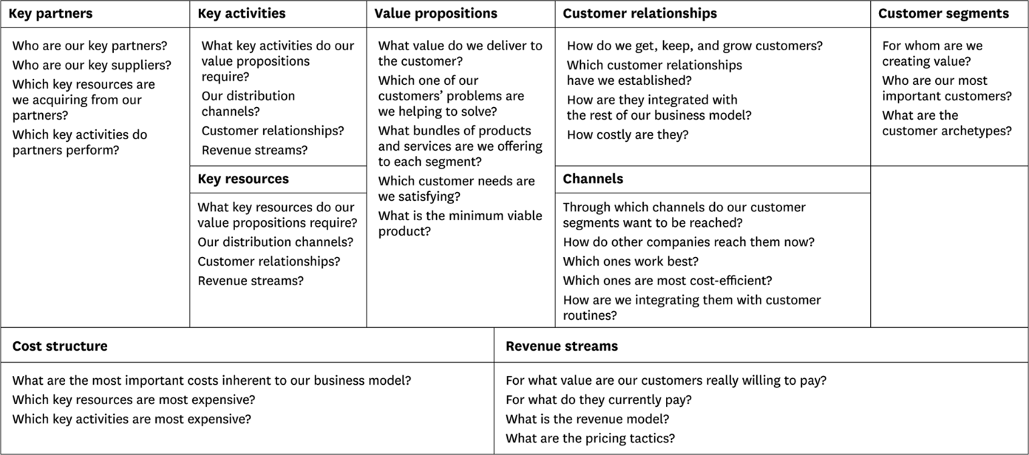
Business Model Canvas by Alexander Ostervald
Ref: www.businessmodelgeneration.com/canvas

Slide 153
Lean canvas – a simplified model
However when are in the early stage, it may not be necessary to go so much into detail, because our product is not yet ready, it has not been validated and many things will change which will yield the model redundant / waste.
Hence a simplified canvas called Lean Canvas is recommended at this early stage. This was proposed by Ash Maurya. Helps get your idea(s) out from your head into a tangible format so that you can communicate that with others

Slide 154
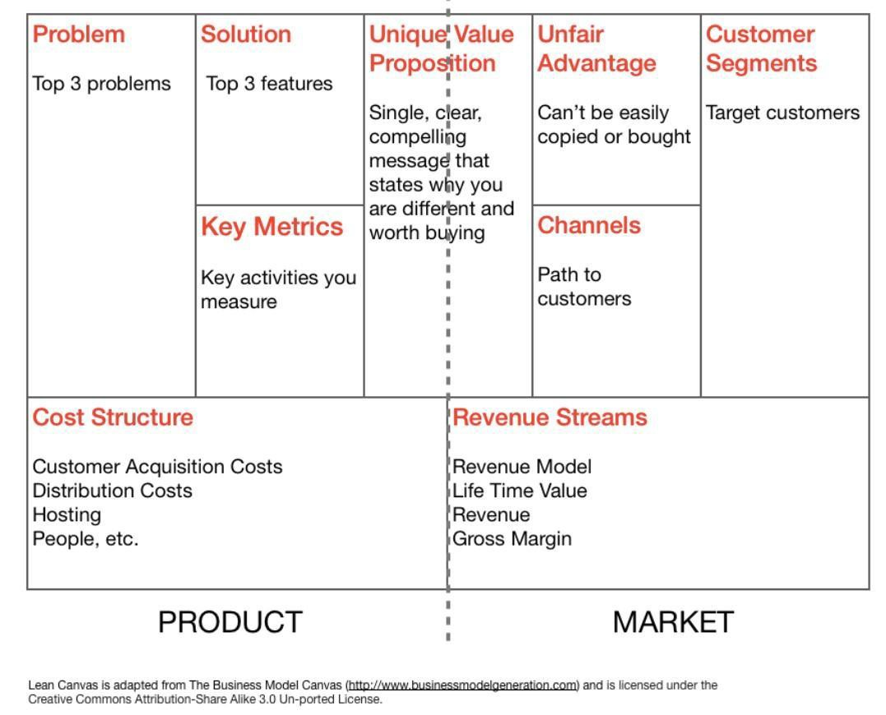
Lean canvas
Ref medium.com

Slide 155
Some explanations
Channels can be email, social, CPC ads, blogs, articles, trade
shows, radio & TV, webinars etc.
Metrics can be how many visited, how many signed up, what is
the usage, how many continued using
Unfair advantage can be insider information, a dream team, getting expert endorsements, existing customers etc

Slide 156
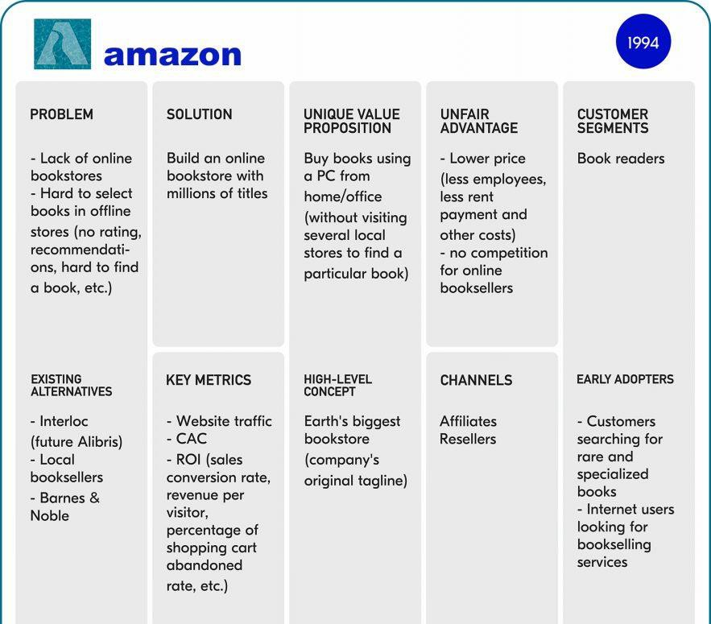

Slide 157
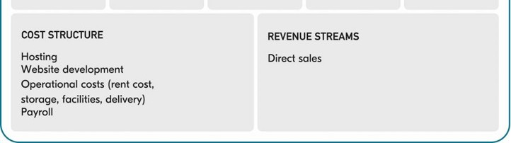
Amazon Lean Canvas…
https://railsware.com/blog/5-lean-canvas-examples/

Slide 158
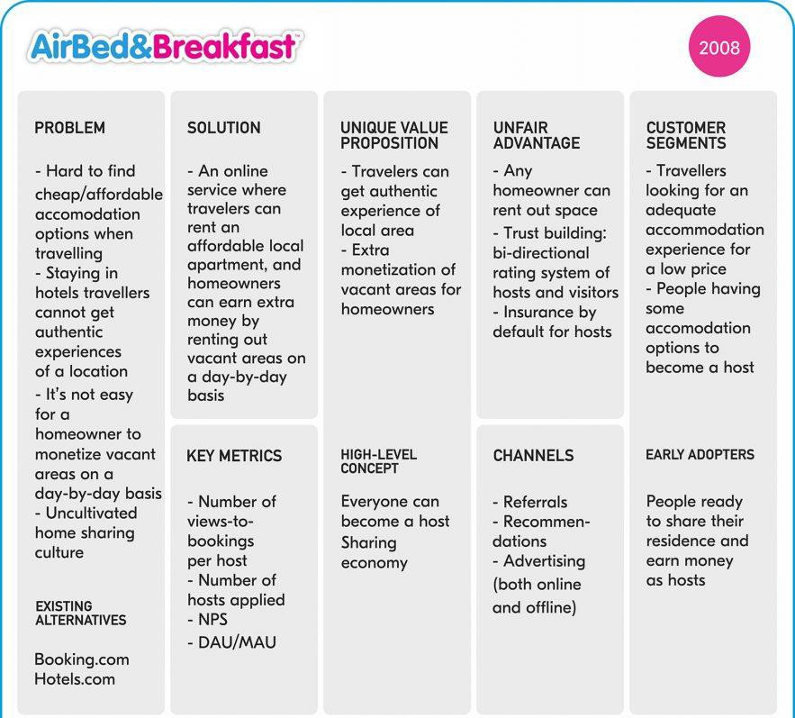

Slide 159
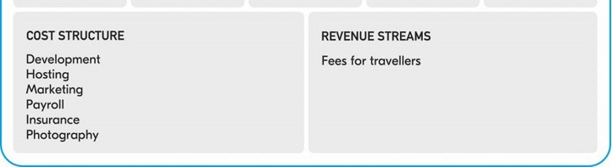
AirBnB Lean Canvas…
https://railsware.com/blog/5-lean-canvas-examples/

Slide 160
Exercise
Create a Lean Canvas for
Rivigo
Qalara

Slide 161

Solution

Slide 162
Appendix

Slide 163
Software Product Management
Specify product features –
Story Map
BITS Pilani
Nandagopal Govindan

Slide 164
Contents
Story map
Classification of features: Kano model
Exercise

Slide 165
Introduction
Once we have understood the need and we have assessed the need by interacting with customers & users, we need to capture all the requirements / features / functionality
Story map is an effective tool to capture the features
Invented by Jeff Patton

Slide 166
Story map: Job portal
Find job
Manage
vacancy
Recruit
candidate
User Activities (backbone)
Browse jobs
Post resume
Receive job alert
Post vacancy
Cancel vacancy
Search candidates
Contact candidates
User Tasks (skeleton)
Search jobs (basic)
Upload resume - PDF
Subscribe for job alert
Submit job vacancy
Select job vacancy
See job applicants
Send message
Search jobs - location
Upload resume – MS Word
Receive SMS for newly posted jobs
Remove job vacancy
Read message (applicant)
User
stories
Build resume with resume builder
Receive SMS alert - last date approaching
Send interview request
Respond to interview request
https://www.visual-paradigm.com/guide/agile-software-development/what-is-user-story-mapping/

Slide 167
Story map: Job portal
Find job |  |  |  |  |  | Manage vacancy |  |  |  | Recruit candidate
Browse |  | Post |  | Receive job |  | Post |  | Cancel |  | Search |  | Contact
jobs |  | resume |  | alert |  | vacancy |  | vacancy |  | candidates |  | candidates
User activities
User
tasks
Search jobs (basic)
Upload resume - PDF
Submit job vacancy
Select job vacancy
See job applicants
Send message
Release
1
Search jobs - location
Upload resume – MS Word
Remove job vacancy
Read message (applicant)
User stories
Build resume with resume builder
Subscribe for job alert
Receive SMS alert - last date approaching
Send interview request
Release 2
Receive SMS for newly posted jobs
Respond to interview request
https://www.visual-paradigm.com/guide/agile-software-development/what-is-user-story-mapping/

Slide 168
About Story map
Story map
Uses top down
Helps organize features based on importance
Helps plan releases

Slide 169
Exercise
Create story map for:
Hotel booking software

Slide 170
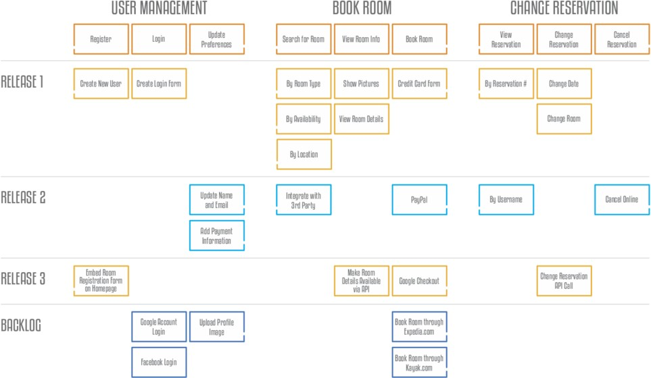
Solution

Slide 171
We need to classify and prioritize features: Kano model
Classification of product features:
Must have
Wants
Delighters

Slide 172
Classification of features: Example: Laptop
Must have | Wants | Delighters
2 Ghz CPU 4 MB RAM 1 TB Disk | OS pre-loaded Anti-virus Finger print scanner Touch screen Dolby sound Log battery life Light weight | Green PC (low power consumption) Spill proof (water proof) key board 4G card for internet

Slide 173
Classification of features: Job portal software
Must have | Wants | Delighters
Post vacancy | Get job alert | Resume builder
Apply | Hot job indicator | Good Interview videos
View |  | Tips to negotiate salary
applicants |  | Psychometric test

Slide 174
Classification of features: Job portal software
Must have
Wants
Delighters
Post vacancy
Apply
View applicants
Get job alert
Hot job indicator
Resume builder
Good Interview videos
Tips to negotiate salary
Psychometric test

Slide 175
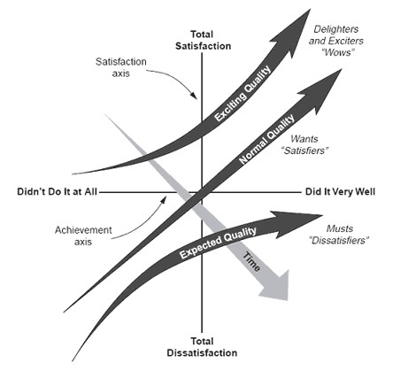
Classification of features changes over time…
As people start using the products, some features move on from Wants to Must haves and Delighters to Wants.

Slide 176
Classification of features changes over time…
Example of delighters becoming wants: Job portal software
Must have
Wants
Delighters
Post vacancy
Apply
View applicants
Get job alert
Hot job indicator
Resume builder
Good Interview videos
Tips to negotiate salary
Psychometric test

Slide 177
Exercise
Identify ‘Must have’, ‘Wants’ & ‘Delighter’ features of
Online banking
Airline reservation
eCommerce

Slide 178
Appendix

Slide 179

Story map: Email system
https://medium.com/@mal.sanders/top-5-takeaways-from-user-story-mapping-by-jeff-patton-f8c80cf73750

Slide 180


Software Product Management
Create Minimum Viable Product (MVP)
Nandagopal Govindan
BITS Pilani

Slide 181
Contents
What is MVP?
Types of MVP
When to use which MVP?

Slide 182
Introduction
Product is a risky business
We should not wait to develop all the features to launch it.
Rather we should develop a product with just enough functionality for users to use it meaningfully and derive significant value from it.
Such an approach will reduce risk

Slide 183
What is MVP?
Frank Robinson says ”The MVP is the right-sized product for your company and your customer. It is big enough to cause adoption, satisfaction, and sales, but not so big as to be bloated and risky
Eric Reis says ““The minimum viable product is that version of a new product which allows a team to collect the maximum amount of validated learning about customers with the least effort.”

Slide 184
What is MVP?...
A Minimum Viable Product helps entrepreneurs start the process of learning as quickly as possible. It is simply the fastest way to get through the build-measure-learn feedback loop with the minimum amount of effort.
Its goal is to test fundamental business hypotheses
Is this the need?
Is there enough value? (Product–Market fit)
Does it make business sense?

Slide 185
MVP need not always be a
product…
It can be a
Prototype
Video
Anything that allows us to test the value

Slide 186
Different types of MVP

Slide 187
Facebook MVP
Facebook used a simple platform that connected students from the same classes by allowing them to post messages to shared boards.
By introducing Facebook to a super-narrow segment of the market, Zuckerberg managed to validate his idea

Slide 188
Uber MVP
When Uber (then called UberCab) launched in 2009, it only worked on iPhones or via SMS, and it was available only in San Francisco.
Uber’s MVP was enough to prove that the idea of a cheap ride-
sharing service had a market.

Slide 189

Dropbox MVP
Dropbox used a video to test hypothesis
https://www.youtube.com/watch?v=xy9nSnalvPc&feature=em b_title
The video led to 75,000 people waiting for a beta invite, literally overnight

Slide 190

AngelList MVP
AngelList is a vast directory of startups and investors, powered by intelligent match-making algorithms and search functionalities.
Babak and Naval were doing manual email intros between startups and investors using their broad network of contacts.
Only after they saw a potential in their idea, did they build their first website.

Slide 191
‘Buffer’ MVP
Buffer:
Buffer is tool that allows scheduling your Tweets
The founder Joel Gascoigne did something similar to Dropbox’s
MVP.
However, instead of a video, the smoke test was a minimal landing page.

Slide 192

Buffer

Slide 193

AirBnB MVP
Back in 2007, there was a great design conference in San Francisco. Hotels were over booked
The Airbnb team decided to offer their house on rent
They hacked together a website to advertise.
They got 3 guests.
This supported the market insight that potential customers would be willing to pay
to stay at someone else’s home rather than in a hotel.

Slide 194
Aardvark MVP
Wanted to develop a product which will answer questions like
”What is a good place to have Italian food?”
They developed a front-end to ask questions, but these were answered by humans. There was no software in back-end.
Once they found that there was a demand, they automated it. (Lean Startup)

Slide 195

Oculus VR MVP
Oculus VR
Founder/s: Palmer Luckey was 20 years when he got the idea
The Idea: Oculus Rift was created with a simple idea of bringing VR experience to passionate gamers
Crowdfunding: Kickstarter campaign started in 2012
Funded: $2,437,429 USD
Backers: 9,522 people
Business Today: Revenue from Oculus Rift is forecasted to amount to 4.95 billion U.S. dollars worldwide in 2019 and that’s only from hardware
Website: https://www.oculus.com/

Slide 196

PopSocket MVP
PopSocket
Founder/s: David Barnett, professor of philosophy in Colorado
The Idea: First version of PopSocket was created to keep the cables from the earphones organized and tied to the smartphone
Crowdfunding: Campaign started in 2012 on Kickstarter
Funded: $18,591 USD
Backers: 520 people
Business Today: In 2018, PopSocket LLC’s revenue was over
$200 million U.S. dollars, with a profit of over US$90 million.
Website: https://www.popsockets.com/

Slide 197
Summary of MVP types
Video
Simple product Concierage Landing page
(Fake door) Wizard of Oz Crowdfunding
: DropBox
: Facebook, Uber
: AngleList, AirBnB
: Buffer
: Aardwark
: Oculus
Have you come across any other types of MVP?

Slide 198
When to use which MVP?
MVP type | When to use
Video (Dropbox) | When product is simple and when it is easy to explain using Video
Simple product (Facebook) | When investment is hot high and when experiencing the product is important to get a feel
Concierage - do it manually (AngleList, AirBnB) | When the concept is very new and when developing a simple version is time consuming
Landing page (Buffer) | When you do not have money to develop
Wizard of Oz - do it manually behind the scene (Aardvark) | When developing the product is time consuming
Crowdfunding (Oculus, Popsocket) | When investment is high
Prototype - clickable | When product has many features
What do you think?

Slide 199
Exercise
Which type of MVP would be suitable for these products?
Online library
Software product finder / advisor
Apna – job finder for blue collar workers

Slide 200
Possible solution…
Product | MVP type | Justification
Online library | Video, crowd funding | Expensive to develop – storage, data management, tie up with publishers
Sw product finder / advisor | Do consulting to check demand (Concierage) | New concept. Not sure if there is demand
Apna - job finder for Blue collar | Prototype | Need to feel the product Blue collar workers need to see the product before they can say if it is useful & usable

Slide 201
Experience sharing…
What was the MVP of your product?

Slide 202
Appendix

Slide 203
Software Product Management
Build, Measure, Learn & Pivot
BITS Pilani
Nandagopal Govindan

Slide 204
Contents
Build
Measure
Learn
Pivot or persevere
Turn ideas into product
See how customers respond
What is valuable to customer
Profile: Kate Arnold of Netflix (Inspired)
Case study: Slack journey (FirstRound)
Case study: “Design Within Reach” (4 Steps to Epiphany)

Slide 205
Introduction
Growth should be measured by the value it creates, not by the
funding, amount of advertisement, etc. – Eric Ries of Lean Startup
Financial valuation of a company may increased for different
reasons – venture funding, lack of competition, etc.
Real growth should be measured by the growth in value to customers
Example:
Are ecommerce customers finding it convenient shop?
Are they finding the products they want?
Are the products delivered on time?

Slide 206

Build-Measure-Learn cycle
So we need to constantly learn what is valuable to customers
Customer interviews Root cause analysis
Agile
Continuous integration
Minimize total time through the loop
# Visits, conversion, retention
How many use new feature?

Slide 207
Build
Build the product with minimum features, yet bringing compelling value
Example: Bounce Minimum feature:
Book
Unlock
End ride
Pay
Features that can be left out for now:
Give feedback (assuming there is a call center)
View bike model and year of manufacturing
Frequent user analytics

Slide 208
Measure
Identify the right metric that indicates that customers are getting value from the product
Example:
# of rides per day in case of Bounce
# of messages / team in case of Slack
Eric Ries calls this as Innovation accounting (as opposed to accounting profit or review)

Slide 209
Measure …
A disciplined approach is needed to figure out if we are making progress through validated learning
Steps:
Establish a baseline using real data based on MVP
Example: 20 rides per day during MVP
Set a desired target: Reach a target of 100 rides in 3 months (based on certain assumptions)
Tune the engine, ie. make optimizations (such as UI improvements or adjust price) and measure again to see the difference
Pivot, ie. Make change to product feature or change target customer or some other change, if the desired outcomes are not met
Example: Provide helmet, Target delivery boys instead of Metro riders (based on a new hypothesis)

Slide 210
Growkit case (Lean Startup)
Farbood Nivi was a popular & effective teacher
He discovered that a combination of following approaches is needed effective teaching:
Teacher led lecture
Individual home work
Group study (Peer-driven learning)

Slide 211
Growkit case …
Step1 :
Used WebEx to teach (Teacher-led learning)
Measured # of customers, # of questions answered, etc.
Added new ways for students to interact with each other. Conducted split (A/B) test. But this did not improve customer behavior.
Allowed lazy registration feature. Conducted split (A/B) test. But this also did not have any impact (Optimization)

Slide 212
Growkit case …
Step2:
They had missed implementing one important need: Choice of solo learning and group learning
Introduced this feature and did A/B testing
This led to significant increase in customer behavior

Slide 213
Experience sharing
Did you make any changes to the product to enhance value?

Slide 214
Importance of A/B testing
Do not add a feature unless A/B testing reveals value to customer

Slide 215
Metrics should be actionable, accessible, auditable
Actionable:
We should be able to take some action based on the metric. Example:
Consider 2 metrics in a gaming software
% of visitors who signed up for a gaming software
# of chat messages exchanged between players
Signup % is actionable. If it is not improving, we can try to investigate and make changes
# of chat messages exchanged: This metric is not a very actionable. We are not sure what action to take

Slide 216
Metrics should be actionable, accessible, auditable
Accessible:
The metrics should be easy to understand. Eg. IMUV – a multi-player
game
How many downloaded
How many used trial version
How many upgraded to paid version

Slide 217
Metrics should be actionable, accessible, auditable
Auditable (verifiable):
Sometimes when A/B test reveals that a feature is not impactful, some people who proposed the feature do not want to give up and start questioning the veracity (dependability) of the data.
They say that the data collected may be inaccurate
In such situations it should be possible to know which users preferred the new feature and who did not.
Then we can do a random check by calling those people and validating the data.
So we need to record customer names and contact details of customers who used the feature and who did not

Slide 218

Votizen case
David Binetti started Votizen (he was earlier manager of USA.Gov)
He wanted to tackle the problem of civic participation in the political process

Slide 219
Votizen: MVP
Hypothesis: People interested in civic matters would like to engage with other similar people
Created a social networking platform for verified voters to get together, share ideas, recruit friends
Only 5% signed up
Tried to make it easier to use. Signup increased by 17% (used A/B testing)
He did more optimization. But sign up remained at 17%. Which means the citizens were not getting much value.
He had heard recurring feedback that citizens wanted to get more involved
So he decided to change the strategy

Slide 220
Votizen: Pivot (Zoom In)
New hypothesis: Passionate activists would be willing to pay for facilitating contacts with elected representatives
Converted into social lobbying platform “@2gov” that enabled
citizens to reach elected representatives
Citizens would use existing social media platform such as Twitter to send message to @2gov and this message would be passed on to the elected representatives on paper since the politicians were less tech savvy
Signup increased to 42% but people willing to pay was just 1%. Revenues remained low

Slide 221
Votizen: Pivot (Customer segment)
Hypothesis: Large org, non-profit org. and fund raisers who are interested in political campaigning would be interested to contact the elected representatives
David contacted them and many signed LoI (Letter of Interest).
After developing the product, org did not show interest in paying for it ,in spite of multiple follow up

Slide 222
Votizen: Pivot (Platform)
Getting inspiration from Google AdWords platform, he converted the product into a self-serve platform for citizens to send message to elected representatives at 20 cents per message.
Revenue increased significantly from 1% to 11%

Slide 223
Votizen: Quick iterations
1st MVP took 8 months
₂nd ₃rd ₄th
4
3
1

Slide 224
Votizen: Lesson
We should not get stuck on our ideas and replace the hypothesis based on new learning about the customer.
The company could have got funding and survived but the value would not increase.
That is why we must measure the impact of each change and decide if we should pivot or persevere with what we have.

Slide 225
Votizen: Achievements
The company got a funding of $1.5 million from Facebook’s initial
investor Peter Thiel.
Startup Visa campaign used Votizen which resulted in the Startup Visa Act (S.565).
This was the first legislation introduced via social lobbying.

Slide 226
Types of pivots
Zoom in: One feature blown up
Zoom out: Many features combined into one as there is not much interest in so many features. Example
Customer segment: Individual or Organization
Customer need (through customer intimacy)
Eg. Pot Belly sandwich which started as an antique store (1977) gave sandwiches to customers to make them stay. But they found that customers like sandwiches more than antiques
Platform pivot: A specific use application to a platform (like AirBnB)
Channel pivot. Instead of selling a product via consulting firms, a company may decide to sell directly (SaaS).
Business architect pivot: Low volume high margin to High volume low margin. Example Clinic shampoo Sachet
Technology pivot: Same solution using different technology (eg mobile) this is used by large corp to improve their service.
Engine of growth pivot: Viral, sticky or paid growth

Slide 227
Experience sharing…
What pivots did you use in your product to enhance value?

Slide 228

Pivot case study: Netflix
What was the solution used by Kate to address the problem of customers not bothering to return the DVD?
How did they address the issue of needing to stock popular & expensive DVDs which were in high demand?
What can we learn about the role of Product manager from this story of Kate?

Slide 229

End-to-end Case study
What lessons can we learn from Slack in the area of:
MVP
Pivot
User vs Buyer
Identifying product features
Marketing & growing the market
Customer support
Strategy
Metrics & Analytics

Slide 230

End-to-end case study
What was the pain point Rob was trying to address?
What was the MVP he used?
Why did Rob refuse to start e-com business?

Slide 231
Appendix

Slide 232
Software Product Management
Rapid solutioning – Sprint
technique
BITS Pilani
Nandagopal Govindan

Slide 233
Contents
Map the problem
Sketch the solution
Choose the best solution
Storyboard
Prototype
Test

Slide 234
Introduction
Quick solutioning & testing its effectiveness is important
Sprint is technique developed by Jake Knapp who used this technique in Google
He found ‘Sprint’ more effective than brainstorming to find solutions to problems, irrespective of the product – software, robot, healthcare
In brainstorming, he observed that much time was spent in discussing pros & cons of each solution. Also he found that resulting solutions were not always the best (Why?)

Slide 235
Idea in brief…
1. Map the problem: Draw a high level process map (swim lane), identify the key challenges to be addressed in the process
1. Sketch the solution: Create rough solutions – one per team member
1. Choose the best solution: Identify stand-out ideas in each solution, by voting
1. Storyboard: Create a storyboard by putting together the standout ideas
1. Prototype: Create a prototype – PPT, video, mockup, wireframe, etc.
1. Test: Show to potential users and get feedback

Slide 236
Steps in detail…

Slide 237

Map the problem
Process for enrolling patients for drug trials

Slide 238
Flatiron
Flatiron is a heath care company that analyses medical records and test data of cancer patients and help doctors to choose the right treatment.
Objective: Increase enrolment in clinical trials for new drugs (medicines)
Problem: Only 4% of cancer patients enrol for clinical trials. Increased enrolment would increase the collection of data about cancer treatment data which can be used by doctors to better treat future patients
There are different types of trials: Trials for drugs for common types of cancer, trials for drugs for rare forms of cancer. The types of trails are very many and it is hard to track humanly.
To determine which trial a patient should undergo (match), the doctors have to go through a lot of data such as treatment history, blood count, DNA mutations in cancer cell, and much more.

Slide 239

Map for Robot server in hotel
Picture of robot

Slide 240

Map: Online coffee sales

Slide 241

Map: Identify the key challenges to be addressed
HMW: How may we?

Slide 242
Map: Identify the key challenges to be addressed
How may we make it easy for customers to re-order?

Slide 243
Exercise
AirBnB: How may we questions:
What are the key challenges AirBnB needs to answer for their
offering – stay in a house instead of staying in hotel?
How may we make it super easy to book a place to stay?
How may we create trust between two complete strangers?

Slide 244

Sketch the solution
How may we make it easy for customers to re- order?
Step 1
Step 2
Step 3

Slide 245

Identify standout ideas by voting

Slide 246
Create Story board
Pick the best solution based on votes. Product manager gets extra voting rights
If there are some stand out ideas in another solution, try to integrate the idea into the best solution
Put together story board of the final solution

Slide 247
Create a prototype
Divide prototyping work among team members
Prototype can be a video, mockup, wireframe, etc.
Build the prototype: Assemble the parts

Slide 248
Test the prototype to get customer feedback
Studies have shown that 5 users are enough to get 80-90% feedback
Understand customer background
Introduce prototype
Let customer use the prototype while someone takes notes
Quick debrief: Good aspects, aspects toimprove

Slide 249
Test: In detail…
Studies have shown that 5 users are enough to get 80-90% feedback Welcome
Thank for coming
We are trying to improve our product,…
I will be asking a lot of questions as you use the product but I am not testing you, I am testing the product
If you get stuck or confused, it is not your fault. It helps us find problems.
I will start by asking some background questions, then I will show you somethings we are working on
Understand customer background
What kind of work do you do?
How long have you been doing that?
What do you do when you are not working?
Have you used any products to ….? What did you want them to do for you? What do you like or dislike
about them?
Introduce prototype
Would you be willing to look at some prototypes?
Some things may not work quite right yet – if you run into something that is not working, I will let you know
Remind the customer, you are not testing the customer
Encourage the customer to think aloud as she uses the product – say what she is trying to do, how she
plans to do, share what she likes, what she is confused about, etc.
Let customer use the prototype while someone takes notes
Ask questions to understand what the customer thinking or getting stuck about
Quick debrief
What did you like about the product, what did you dislike?

Slide 250
Case study: Slack
Slack messaging software had become hugely successful in tech companies. 500,000 users were using it for one-on-one messaging, chat room messaging,.. It had changed the way teams communicate. It had integrations with lots of other application and had become a hub.
Now Slack wanted to expand to non-tech companies. The marketing had not made much impact. So they got together to use Sprint approach to answer the questions – what is the best way to explain what Slack can do for you?
The team came up with 2 competing ideas – tenacious tour and Bot. They developed a prototype for each. One was a step by step explanation of Slack usage. Another was a mock up of a Bot – messages typed by the user will be answered by a Slack employee at the other end mocking a Bot.
The team showed these prototypes to 2 sets of users. The tenacious tour got better feedback though with some room for improvement. Thus they avoided the effort of developing the Bot which would have been quite expensive.

Slide 251
Exercise
Product: Digital music player device for senior citizens
1. What are the key questions / challenges?
1. Sketch a solution / UI for downloading a song and storing it in the device

Slide 252

Exercise: Digital music player device for senior citizens
Map (Swim lane)
Son / Daughter
Buy device
Subscribe to a plan
Senior citizen
Download songs
Play songs
1. What are the key questions / challenges? Let us now prioritize the challenges https://docs.google.com/document/d/1PX7yRRSwWluzKA5pFy7kc3P861kdWhOQl8D BW8Nu0ew/edit?usp=sharing
1. Sketch a UI solution for downloading a song. Let us vote for the best solution.

Slide 253
Example of HMW questions
HMW questions: How may we make it easy for senior citizen to
1. Search & download a song or a set of songs, for example all
songs from the Hindi film “Anand”?
1. Search & play a downloaded song?

Slide 254
Exercise…
Sketch a UI solution to search for & download a song
Then copy paste your UI solution in the same document
https://docs.google.com/document/d/1PX7yRRSwWluzKA5pFy7kc 3P861kdWhOQl8DBW8Nu0ew/edit?usp=sharing
Then let us vote for the best solution.

Slide 255
Key learnings
What are the key learnings from this “Sprint” technique?

Slide 256
Appendix

Slide 257
Software Product Management
Principles of UX design
BITS Pilani
Nandagopal Govindan

Slide 258
Contents
Dimensions of Usability (Jakob Nielsen)
Steps for UI design
Different aspects of UX design
Evaluating UX – Nielsen’s heuristics

Slide 259
Introduction
Have you come across User interfaces that exhibit the following:
Unintuitive and hard to use.
You can't find what you're looking for
You're not clear what to do next.

Slide 260

Introduction
One way to evaluate UX is to consider how much it helps or hinders the functionality / features in realizing the value proposition (the desired customer benefits) (Product – Market fit pyramid)

Slide 261


Dimensions of Usability
Learnability: How easy is it for users to accomplish basic tasks the first time they encounter the design?
Efficiency: Once users have learned the design, how quickly can they perform tasks?
Memorability: When users return to the design after a period of not using it, how easily can they re-establish proficiency?
Errors: How many errors do users make, how severe are these errors, and how easily can they recover from the errors?
Satisfaction: How pleasant is it to use the design?

Slide 262
Dimensions of Usability
Consider the following:
Learnability: How quickly can you learn to use these - washing machine, Gmail, online banking
Efficiency: How efficiently can you accomplish your task using these – MS
Word, 50 process templates to choose from in Kissflow
Memorability: How long does it take to use these when you return again to use them - Airport kiosk to print boarding pass, Movie theatre kiosk to print ticket
Errors: How many errors do you make while buying a product on Flipkart?
Satisfaction: How pleasant was your experience using MakeMyTrip.com?

Slide 263
Exercise: Give examples
Dimension | Good product example
Learnability
Efficiency
Memorability
Error
Satisfaction

Slide 264

Exercise
Comment on the “Efficiency” dimension of booking an flight ticket in
MakeMyTrip.com

Slide 265
Basic steps
Design the overall structure
Consider the different scenarios (use cases)
Design navigation & screens for each scenario

Slide 266

Example: Overall structure

Slide 267

Example: Sketch of overall structure
Portal for travelling nurses
Show different areas using rectangles
This is an iterative process

Slide 268

Example: Scenario: Searching & selecting products to buy

Slide 269

Example: Navigation

Slide 270

Example: Screen design

Slide 271

Example: Screen design

Slide 272
Ideal sequence for design
Sketch => Wireframe => Lo-fi Prototype => Hi-fi Prototype => Code

Slide 273

Different aspects of creating UX
Conceptual design
Information architecture
Interaction design
Visual design

Slide 274
Conceptual design
Should resonate with how the users think (Mental model) Examples:
Quicken used checkbook as a metaphor, which customers found very intuitive.
Uber's conceptual design was to show users the location of nearby cars in real time:
Tally: User’s language not Accountant’s language
MakeMyTrip: Steps to book ticket match users expectations
Need to understand users and their goals (personas)
How tech savvy is the customer?
What is the age?
What is the environment in which he will be using the product (in a car while driving, in a noisy factory)

Slide 275
Exercise: Conceptual design
Comment on the conceptual design of the “Funds transfer” feature of your bank’s online banking software

Slide 276
Information architecture
Deals with how you organize information on the screen
Findability is a key measure
Organize features, label them in a way that is easy to understand
Organize in sections and screens within sections (Site map)
Global navigation pattern

Slide 277

Information architecture: Example of bad design
How you like this screen design?

Slide 278
Exercise: Info architecture
Comment on the “Findability” aspect of your bank’s online
banking software
How easy or difficult it is to find the following features:
Order cheque book
Block debit card
Access Form 16

Slide 279
Interaction design
Deals with:
What actions can the user take at each step, and how will the product respond?
How will the user interact: click, hover, drag, type, tap, swipe, etc.
What navigations needs to be provided?
Depicting the state, such as - Product selected, checkout, payment
How does the product provide feedback?
Error messages,
confirmation,
acknowledgement for pressing a button,
wait indicators (hour glass),
progress bar,
‘you are here’ indicator in a multi step process
Which product you have used that gives good feedback?

Slide 280
Customer journey mapping (different touch points)
A customer journey is the end-to-end process that a customer goes through in order to complete a task over time
Customers interact with an application using multiple devices – laptop, smart phone, kiosk – and in multiple ways – email, browser, sms. (touch points)
Example: Airline travel
Book ticket using laptop
On day of journey, the airline sends me a notification to check in
I show my phone boarding pass at gate
I print boarding pass on kiosk
If there’s a flight delay, I’m updated immediately by text message or email.

Slide 281
Exercise: Customer journey mapping
Can you give example of customer journey mapping for Customer complaint of lost credit card?

Slide 282
Visual design (Graphic design)
Deals with:
Colour (highlight, borders, title)
Hierarchies (Heading, sections, …)
Brand personality (Company logo)
Fonts
Images (AirBnB)
Icons (Save, Edit, …)
Style guide for consistent design

Slide 283

Visual design: Hierarchy

Slide 284

Evaluating design:
Nielsen’s heuristics
Simple & Natural dialogue – minimize concepts, match user’s mental model
Speak user’s language – avoid codes such as 44 for UK, 1 for US, avoid technical
terms such as memory overflow
Minimize user memory load - Use menus and drop downs
Consistency – Example menu items across Word, Excel, Powerpoint
Feedback – Confirmation of action, Progress indicator
User control & freedom – Example Home, Back, Undo, Redo
Clearly marked exits – Cancel, Logout
Shortcuts – Ex. Word shows last files opened, prefill preferences, default values
Good error messages – Precise and helpful: Can not open file Chapter 5 because it is not on disk”. It is possible that the file has been moved to new directory or might have been renamed”
Prevent errors – Example Drop down values, Calendar to select date, Describe the
format ex. dd-mmm-yyyy 2-Oct-2048, Make primary action prominent
Help & Documentation – Task oriented search
Revised & Excellent: https://www.nngroup.com/articles/ten-usability- heuristics/

Slide 285
Summary
We looked at:
5 dimensions of Usability: Learnability, Efficiency, Memorability, errors & Satisfaction
4 aspects of design: Conceptual, Information architecture, Interaction design, Visual design
Evaluation heuristics of Nielsen

Slide 286
Question
What are the key learnings from this session?

Slide 287
Appendix

Slide 288

Information architecture: Example of poor organization
Al Gore from the Democratic Party, lost many thousands of votes, which instead went to the Reform Party.

Slide 289



Elegance & Simplicity

Slide 290

Balance
Source: https://www.interaction-design.org/literature/topics/visual-design

Slide 291
Software Product Management
Design thinking
BITS Pilani
Nandagopal Govindan

Slide 292
Contents
Introduction
Steps in Design thinking
Examples
Case study

Slide 293
Introduction
Design thinking is a human-centered approach to innovation— anchored in understanding customer’s needs
Design thinking believes that Innovation is powered by a thorough understanding, through direct observation, of what people want and need in their lives

Slide 294
5 steps of Design Thinking
Empathize: Understanding the user and the problems they face through conducting user interviews, creating empathy maps, and listening to user stories.
Define: Organizing and analyzing the research information to produce a
concise problem statement and possible solution or hypothesis.
Ideate: The brainstorming phase. Designers think of a wide variety of
possible solutions and evaluate each one.
Prototype: Turning ideas into a physical representation of the product that will solve the user’s needs, slowly adding greater detail and complexity as designers move between testing and iteration.
Test: Putting the prototype in the hands of the user and determining whether the product has solved the problem at hand and reduced friction or frustration.

Slide 295

Example of design thinking at Kaiser hospital
Problem statement
At Kaiser hospitals, nurses routinely spent the first 45 minutes of each shift at the nurses’ station, debriefing the departing shift about the status of patients
Nurses often failed to learn some of the things that mattered most to patients, such as how they had fared during the previous shift, which family members were with them, and whether or not certain tests or therapies had been administered.
For many patients, each shift change felt like a hole in their care.

Slide 296
Example of design thinking at Kaiser hospital
Solution
The design that emerged for shift changes had nurses passing on
information in front of the patient rather than at the nurses’ station.
In only a week the team built a working prototype that included new procedures and some simple software with which nurses could call up previous shift-change notes and add new ones.
They could input patient information throughout a shift rather than scrambling at the end to pass it on.
The software collated the data in a simple format customized for each nurse at the start of a shift.
The result was both higher-quality knowledge transfer and reduced prep time, permitting much earlier and better-informed contact with patients.

Slide 297
Example of design thinking at Kaiser hospital
Method
The core project team included a strategist (formerly a nurse), an organizational-development specialist, a technology expert, a process designer, a union representative, and designers from IDEO.
This group worked with innovation teams of frontline practitioners in each of the four hospitals
Close observation, combined with brainstorming and rapid prototyping, produced new procedures and software that radically streamlined information exchange between shifts.

Slide 298

Case study: ANA Tomo
A travel companion for the elderly to navigate through the airport

Slide 299
Case study: ANA Tomo
Challenge
ANA is Japan’s biggest airline.
Has a large pool of businessmen customers
ANA seeks to adjust to Japan’s upcoming demographic
circumstances: the aging society.
ANA wants to cherish the retired businessmen who accompanied ANA throughout their careers

Slide 300
Case study: ANA Tomo
Solution
ANA Tomo, best travel companion.
ANA Tomo is a portable connected object designed with the active retiree in mind.
It serves ANA elder passengers with live navigation to their boarding gate at the airport.
ANA Tomo also gives passengers relevant, informative cues,
ensuring ANA is by its customers’ side throughout their journey.

Slide 301

Case study: ANA Tomo

Slide 302
Case study: ANA Tomo
Impact
Easily understood by all passengers, ANA Tomo allows them to enjoy their time at the airport while approaching their gate at their own pace, stress free
ANA can find passengers in case they are lost, speeding up the boarding process.
Currently the device is being designed for the duration of one's stay in the airport, but future expansions can include the duration of the flight and even the duration of one's travel. ANA Tomo can easily become the future air ticket.
Ref: https://sugar-network.org/ https://www.me310kyoto.org/anatomo

Slide 303

Case study: UberEats
UberEats:
What are the key learnings from the UberEats example?

Slide 304
Key takeaways from the 5 examples:
Whether it’s a new app, a community service, or a physical product, the best thing you can do to innovate successfully is keep your user in mind at every step in the design process. It can be tempting to create a flashy, high-tech product.
Instead, focus on what your users are asking for.
It’s easy for designers to become disconnected from their user. Don’t be afraid to take risks and immerse yourself in the lives of the people who will actually interact with your product. Then implement their feedback and test your results. Eventually you’ll land on that final iteration with the potential to change the world around you.
https://careerfoundry.com/en/blog/ux-design/design-thinking-examples/

Slide 305


Homework case studies
What are the ley learnings from these case studies in the area of understanding customer needs, ideation, prototyping, iteration?
Case studies from IDEO company

Slide 306
Appendix

Slide 307
Product Management
Agile Method
BITS Pilani
Nandagopal Govindan

Slide 308
Agenda
Agile framework
Sprint phases
Agile team structure
Product Release plan
Estimation
Sprint planning
Progress tracking
Challenges in Agile
Case study
Ref: “Agile for Dummies” by Mark Clayton

Slide 309
Introduction
Traditional software development methods such as Waterfall model
have a major drawback – late detection of defects
Agile breaks the development into short-duration iterations, enabling early detection of errors
Benefits
Improved quality due to quicker feedback
Focus on business value by implementing features of greater value first
Transparency of progress

Slide 310
Agile manifesto (Agile values)
Individuals & interactions over process & tools
Working software over comprehensive documentation
Customer collaboration over contract negotiation
Responding to change over following a plan

Slide 311

Agile framework
Source: “Agile for Dummies” by Mark Clayton

Slide 312

Sprint phases: Planning, Execution, Review & Retrospective

Slide 313

Agile team

Slide 314
Agile team: Roles and responsibilities
Product owner:
Expert in customer business need
Prioritizes requirements
Does acceptance
Scrum master / Agile coach
Expert in Agile process
Communicate with stakeholders
Clears roadblocks
Development team
Multi-skilled – set up environment, automate builds, continuous
integration, refactoring

Slide 315
Experience sharing…
Did you have any other roles?

Slide 316
Product Roadmap
Steps:
Identify stakeholders.
Establish product requirements and add them to the roadmap.
Prioritize requirements based on values, risks, and dependencies.
Estimate the development effort at a high level
Determine high-level time frames for releasing groups of functionality to the customer

Slide 317

Requirements, User stories, Release plan
Home loan application

Slide 318

Product features, Priority, Estimation, Release plan
Source: https://www.scrum-institute.org/Release_Planning.php

Slide 319
Estimation techniques
Estimation Poker
Affinity based estimating

Slide 320

Estimation poker
Poker cards
Numbers represent relative effort of user stories
Steps:
Provide a deck of estimation poker cards.
The team agrees on one user story that would be a 5.
The product owner reads a high-priority user story
Each player selects a card representing the effort involved
If the players have different story points: discuss assumptions, re- evaluate. If members differ, breakdown the story

Slide 321
Estimation Poker
A typical deck has cards has Fibonacci sequence 1, 2, 3, 5, 8, 13
The reason for using the Fibonacci sequence instead of simply doubling each subsequent value is because estimating a task as exactly double the effort as another task is misleadingly precise
Very high numbers are not used in the deck, since it is difficult to accurately estimate a large effort
If the effort can not be estimated, the user story is broken down

Slide 322
Example of Poker estimation
Source: https://www.scrum-institute.org/Release_Planning.php

Slide 323
Exercise
Hotel Room Reservation Mobile app
Business travellers on the move, find it hard to make hotel reservation since they need to open their laptop and make reservations. It would be really convenient if a user friendly mobile app is made available by the hotel.
The UI of this mobile app should be extremely easy to use. It should support functions to Check availability of room, know the price of rooms, make a booking, etc. After their stay, the app should allow the user to provide their feedback.

Slide 324
Exercise
User stories
Room booking
Feedback
Messages from hotel
Look at booking history
Check loyalty points
Cancel booking
Request for information
Register
Login
Logout

Slide 325
Exercise
Prioritize user stories
Room booking
Feedback
View messages from hotel
Look at booking history
Check loyalty points
Cancel booking
Request for information
Register
Login
Logout

Slide 326
Exercise
Prioritized user stories
Register
Login
Logout
Room booking
Cancel booking
Look at booking history
View messages from hotel
Feedback
Check loyalty points
Request for information

Slide 327
Exercise
Create a release plan (Group user stories into releases)
Release 1
Register
Login
Logout
Room booking
Cancel booking
Release 2
Look at booking history
Messages from hotel
Release 3
Feedback
Check loyalty points
Request for information

Slide 328
Exercise
Estimate the following user stories:
Register
Login
Logout
Room booking
Cancel booking

Slide 329

Estimation

Slide 330
Experience sharing…
Did you use this method?
If not, what method did you use?
T-Shirt sizing: Small, Medium, Large, Extra large is another way of categorizing the stories. Each size has an effort associated with it.

Slide 331
Affinity estimation
Used when user stories are many, say 500+
When you have a large number of user stories, many of them are probably similar and would require a similar amount of effort
You quickly categorize your user stories and then apply estimates to these categories of stories

Slide 332
Sprint planning
Set a goal for the Sprint
Select User stories to be developed in the Sprint
Identify the tasks for each user story – design, develop, code
analysis, security hole check, test
Estimate effort for each task
Assign a person responsible for each task

Slide 333

Sprint planning
Sprint goal: Demonstrate the ability of a mobile banking customer to log in and view account balances and pending and prior transactions.

Slide 334

Sprint 1 plan for Hotel room reservation mobile app

Slide 335
Sprint execution
Daily scrum meeting
What was completed yesterday
What challenges were faced
What is the plan for the day
Once a week, a big picture view of the product, its goals, etc.

Slide 336

Burndown chart
JIRA provides this insight

Slide 337
Experience sharing…
How did you track progress in your project?

Slide 338

Feedback cycles

Slide 339

Velocity
# of story points completed per Sprint
Source: https://www.altexsoft.com/blog/business/25-scrum-process-best-practices- that-set-your-agile-workflow-for-efficiency/

Slide 340
Challenges
Lack of skilled product owners from business side
It is difficult to quote fixed price and time due to changing requirements, dependency on client in each sprint
Architectural changes and rework due to new requirements

Slide 341

Case study: Pharma company Inventory management

Slide 342

Results
5 sprints, 100 days (about 4 months). However, results used after the first month

Slide 343
Experience sharing…
What benefit did you get from Agile method?
What challenges did you face?
How did the customer / end user feel?

Slide 344
Appendix

Slide 345

Scrum framework
https://www.altexsoft.com/whitepapers/agile-project-management-best-practices-and- methodologies/

Slide 346
Requirements, User stories, Release plan
Home loan application

Slide 347

Source: https://in.pinterest.com/pin/127086020711755414/?lp=true

Slide 348

Roadmap to value

Slide 349

Product vision

Slide 350
Product vision: Example
For Progressive Bank customers
who want access to banking capability while on the go,
the MyProgressive
is a mobile application
that allows secure, on-demand banking, 24 hours a day.
Unlike
our product
online banking from your home or office computer, allows users immediate access,
which supports our strategy to provide quick, convenient banking services, anytime, anywhere.

Slide 351
Difference between Agile and Scaled Agile
Agile projects are small 3-9 members
Scaled Agile projects have multiple Agile teams.
Coordinating different Agile teams requires additional techniques

Slide 352

Visual progress tracking (Kanban)

Slide 353

Visual progress tracking (Kanban)
Image source: medium.com/@sashabondareva

Slide 354
Software Project Management
Engineering best practices
Nandagopal Govindan
BITS Pilani

Slide 355
Agenda
Continuous integration
Single code base
Product configuration capability
API for integration
Component based design
Prove value, scale later
Platform as a product

Slide 356
Continuous integration (CI)
CI is a practice where developers integrate code into a shared repository frequently
Each integration is verified by an automated build and automated tests.
Key benefit is detecting errors quickly and locate them more easily.
Experience sharing: What benefits have you experienced using CI / CD?

Slide 357
Single code case
Maintaining multiple versions of the software is challenging
Build a core product with common features needed by target customers
Maintain a single code base used by all customers
Sometimes branching strategy is used to cater to different customers, one branch for one customer. But all branches have a common main trunk.

Slide 358
Product configuration capability
Products need customization.
Provide for
Choice of modules (SAP)
Configurable work flows (SaleForce)
Configurable fields (SAP)
Configurable rules (Navitair airline reservation)
Configurable UI (look & feel) (Yahoo! Mail)
Choice of language
Configurable error messages
Anything else?

Slide 359
API for integration
APIs to allow external systems to inter-operate with our product
Examples
Facebook,
SAP,
Open API of banks,
Google Maps,
Git
Any other example?

Slide 360
Component based design
Well decomposed system make a system easy to understand, build and maintain
Web services & Micro-services are examples of components
Components promote re-use
They help in easier scaling & fault detection

Slide 361
Prove value of product, Scale later
Do not design for scale from day 1, because we do not know if the product is useful enough
Example: Zendrive
Zendrive provides insight into driving behaviour such as how does the driver apply brake – sudden or smooth, how safe does the driver turns the vehicle – does he slow down enough before turning, etc.
It captures data from driver’s mobile phone, sends it to the server for
analysis.
Once the product value was proven, they started optimizing the product by aggregating and summarizing data on the phone and sending only summarized data to server, to reduce data transfer time and reduce processing load on central server.
Any other example?

Slide 362
Be open to re-architect
As business grows & expectations change, it may be necessary to re- architect the product
Example
Amazon: Monolithic software to Micro services based software (2- pizza teams)
Adobe Creative Suite: Desktop to Cloud
Oracle apps: On-premise to Cloud
Any other?

Slide 363
Platform as a product
Where appropriate, build a platform
Platform provides a base for building new services (eg Maruti Alto platform)
Example:
Apple, Android, Firefox browser,
AWS, Azure (databases, messaging, serverless, monitoring, etc.)
Eclipse,
MakeMyTrip,
Uber,
AirBnB (During Covid they offered adventure experiences in virtual mode)

Slide 364
Case study: Visio graphics- charting software (sloanreview.mit.edu)
Scores of plug-in modules are available for Visio software that contain all types of industry- biotechnology, petroleum engineering, insurance accident reporting, and process reengineering
Domain experts can add-in shapes (Smart shapes) and programs (charting scripts)
These shapes carry a certain “intelligence” - automatically adjust connections between different shapes when they are moved or resized
Major components of the platform are:
Core graphics engine
SmartShape management subsystem for incorporating and then manipulating graphic objects
An API that provides a standard scripting language so developers can create and integrate their own plug-in programs into Visio

Slide 365
Appendix

Slide 366
Software Product Management
Measurements and Analytics
Nandagopal Govindan
BITS Pilani

Slide 367
Contents
User behaviour analytics
Business analytics
Financial analytics
Performance
Operational costs
Go‐to‐market costs
Sentiment analysis
A/B testing
Case study: Improving business through metrics

Slide 368
Introduction
Product teams use analytics to:
Understand users & then target the right user segments
Understand customer behaviour and improve UX
Measure product adoption & increase value
Measure effectiveness of marketing campaigns

Slide 369
Types of analytics
User behaviour analytics (click paths, engagement)
Business analytics (active users, conversion rate, lifetime value, retention)
Financial analytics (Average selling price, billings)
Performance (load time, uptime)
Operational costs (storage, hosting)
Go‐to‐market costs (acquisition costs, cost of sales, programs)
Sentiment (NPS, customer satisfaction, surveys)
Source: ”Inspired” Chapter 54)

Slide 370
User behaviour analytics
Which features are most popular & which are least
What friction points or issues users are running into
How engaged users are (How often & how long)
The type of users – heavy users, occasional users, freeloaders
What a user workflow looks like

Slide 371

Sample User journey metrics
Source: “Product Analytics for
Dummies”

Slide 372
User behaviour analytics
How can we make use of these insights?
Which features are most popular & which are least?
What friction points or issues users are running into?
How engaged users are (How often & how long)?
Who are our heavy users, occasional users, freeloaders?
What a user workflow looks like for a given task?

Slide 373
Experience sharing
How did you improve your product based on user behavior analytics?

Slide 374

Business analytics
Dave McClure’s AARRR framework
Visits
Conversion

Slide 375
Dave McClure’s AARRR
framework
Acquisition: How many prospects (new visitors) are our visiting to
our website – due to ads, due to Google search, others?
Activation / Conversion: What percentage of prospects that come to our website sign up as customers?
Retention: What percentage of our customers remain active over time?
Revenue: How much money does each customer generate?
Referral: How many customers refer our product to their friends?

Slide 376
Dave McClure’s AARRR
framework
How does this data help us?
Acquisition: How many prospects (new visitors) are our visiting to
our website – due to ads, due to Google search, others?
Activation / Conversion: What percentage of prospects that come to our website sign up as customers?
Retention: What percentage of our customers remain active over time?
Revenue: How much money does each customer generate?
Referral: How many customers refer our product to their friends?

Slide 377
Order of optimization
Which metric should we try to improve first & why?
Acquisition
Conversion
Retention
Revenue
Referral
Recommended Order of optimization
Retention
Conversion
Acquisition
Why?
If we are unable to retain, it implies lack of value

Slide 378
Case study: Intuit
(Improving conversion)
Launched a new web product,
Wanted to track and improve the product and business
Customers were coming but had a conversion problem: the percentage of prospects signing up was lower than we had expected it to be.
Source: Book: Lean Product Playbook

Slide 379
Case study: Intuit…
Did analysis & improvements:
Sign-up process that long.
Many prospects were dropping off at different points in the sign-up process.
Conducted usability testing with users - Discovered several UX design issues.
Quickly made UX design improvements.
Result: 40 percent improvement in our conversion rate
Source: Book: Lean Product Playbook

Slide 380

Measuring retention rate
Source: Book: Lean Product Playbook

Slide 381

Measuring improvement in retention rate
Cohorts
Retention rate of different cohorts, as the product-market fit is
Source: Book: Lean Product Playbook
improved

Slide 382
Revenue related metrics
Average revenue per user: ARPU
Example: Amazon, Ola, RazorPay, Slack, Zoom
Customer Life Time Value = ARPU * Avg. Customer life time (in months or years) * Gross margin
How does this help us in pricing the product?

Slide 383
Sentiment analysis: Net Promoter Score (NPS)
“How likely are you to recommend the product to your friend?”
9 or 10 are called promoters
7 or 8 are called passives
0 through 6 are called detractors
NPS = % of promoters - % of detractors
NPS should increase as you improve product-market fit.
Include in your survey an open-ended question asking customers
why they gave the score they did

Slide 384
Experience sharing…
How did you improve your product based on NPS?

Slide 385
A/B testing
Used when the fear of negative impact of the change is high
A/B testing can be used to test
A change in UI
A change in recommendation algorithm
New feature
Any other?

Slide 386
A/B Testing: Example
Let us say you have a landing page.
You see from your analytics that your conversion rate is only 5 percent, much lower than you think it should or could be;
So you design a new, improved version of the landing page.
Now you allow a small % of users to see the new landing page and see if the conversion rate improves or not

Slide 387

Concept of statistical significance
Let us say the conversion rate increased from 5% to 6%
Is this finding reliable?
If our sample size is small, it is not very reliable
If our sample size is large, the finding is more reliable (statistically significant)
There are tools & formulas to help us determine whether the change is significant or not.

Slide 388
A/B Testing in Netflix
Chief Product Officer Neil Hunt says “We use A/B testing for almost everything”
Examples
Test out different user interface variations
Test recommendation algorithms
Test button placements and sizes
He says “We realize that most of the time, we don't know up-front what customers want. The feedback from testing quickly sets us straight, and helps make sure that our efforts are really focused at optimizing the things that make a difference in the customer experience.”

Slide 389
Experience sharing…
For what purpose did you use A/B testing in your product?

Slide 390

Case study: Friendster’s viral loop
Improving revenue by choosing right metrics to improve
Friendster Viral Loop

Slide 391

Friendster Viral Loop Metrics

Slide 392
Baseline metrics
Percentage of users sending invites = 15 percent
Average number of invites sent per sender = 2.3
Registration conversion rate = 85 percent
Which metric should we try to improve?

Slide 393

The Upside Potential of a Metric
Has max upside potential

Slide 394
Action to improve
Each user has on an average 100-200 friends. Going from 2.3 to 100 will be a significant improvement.
So we introduced a feature to import address book from Gmail or Yahoo mail and allow user to select the friends they want to send invite to
This changed the avg invites from 2.3 to 5

Slide 395

Outcome

Slide 396
Exercise

Slide 397
Appendix

Slide 398
Software Product Management
Ongoing product management
Nandagopal Govindan
BITS Pilani

Slide 399
Contents
Customer support
Product improvement & enhancements
Situations triggering product change
Continuous product innovations (value enhancement)
Software Product Lines

Slide 400
Introduction
A new set of activities begin after product release
Some examples:
Resolving customer issues
Improving the product – UX, performance, bug fixes, security
fix
Keep adding value with relevant features – whole product
Adapt to changes in user needs, technology, competition
Leverage the product – Open source, product line, cater to new
segments

Slide 401
Customer support
Quick and effective customer service is paramount. How?
Make the product so simple to use and so high in quality that support is a non-issue
Support team should be sufficiently staffed & knowledgeable
Recruit people who have a high degree of empathy who feel the pain of the customer
Empower staff to take decisions, example to give refunds where genuine
Examples of excellence in customer support
IBM delivery a small part flying its engineer to customer site,
Buffer Inc. provides superior customer support which helps market itself
Do you have any examples of great customer service?

Slide 402



Measuring customer service at Buffer Inc.
Email responses
Twitter responses
Resolution time
https://buffer.com/resources/june-happiness-report-self-select-urgency/

Slide 403

Support channels
Several support channels can be used:
Email, Twitter, Facebook, Phone, Remote desktop, FAQ, Ticketing system, Bot
What channels of support exist in your organization?
High touch vs low touch:
High touch service involves human interaction as against automated systems (IVR), FAQ, etc.
Mission critical products such as SAP, Navitaire, Shopify, etc. need high touch support
Choose the right channel
Wistia: How did it optimize support?
StudioPress: How did it provide support?

Slide 404
Service Quality
Ensure quality of service using concepts of SERVQUAL

Slide 405

What are the characteristics of a service quality (SERVQUAL)?
Which service quality characteristic is most important in your project?

Slide 406
Service Quality
Reliability is the firm’s ability to perform the promised service accurately
and dependably
Responsiveness is the firm’s willingness to help customer and provide
prompt service
Assurance is knowledge and courtesy of employees and their ability to inspire trust and confidence
Empathy is caring and individualized attention paid to customers
Tangibles refers to physical facilities, equipment and appearance of personnel

Slide 407
Exercise: SERVQUAL
Which service quality are we referring to in the scenario described below:
The hotel room has pleasing colours
Tangibles
When a problem is fixed, another appears
Reliability
When the network fails, it is fixed in 1 hour
Responsiveness
The engineer is able to clear all doubts of customer satisfactorily
Assurance
The engineer understands the urgency and goes the extra mile to help
Empathy

Slide 408

Product improvements & enhancements
Improve the product based on customer feedback
Example
Slack: Integrations with email, channels / group chats
Postman: Documenting APIs, Mocking APIs for front end development)
Any other?
Case study in product improvement: How to listen to customers and analyse them before implementing: Interview with Jim Lynch, Salesforce. What can we learn from this case study?

Slide 409
Experience sharing…
How are customer suggestions analyzed and acted upon in your organization?

Slide 410
Release planning
Minor releases to fix critical issues
Major releases containing new features & enhancements
Feature prioritization can be based on
Value to customers
Need to match competition
Cost of development and support
Technical complexity and dependencies
Urgency of refactoring
How does release planning happen in your company?

Slide 411

Case study of product improvement: Word 6.0
Word 6.0 on Apple Mac OS
Questions:
Why did Microsoft want to converge Word on Windows with that on Mac?
Why did they drop this idea?

Slide 412

Situations triggering Product change
Changing user needs
Amazon Pay-on-delivery
Ola SOS button
Changing regulations – SOX, GST
Changing standards – Word introduced ‘Save as PDF’
Changing technology
Amazon moved from monolithic architecture to Micro-services
Any other type of change?
Case study: Adobe Creative Cloud - Desktop to Cloud
What were the challenges?
How were they overcome?

Slide 413
Experience sharing…
What challenges did you face in making major changes to your product?

Slide 414
Continuous product innovations
We need to continuously add value to clients
Examples:
Netflix: Online order for DVD rental, recommendations feature to make it easy to choose, video streaming, own productions
AirBnB Covid pivot: Virtual experiences – Jungle safari, magic
shows, Rio street art
BigBasket: Vending machine in apartment complex, Booking delivery slot
Women safety in Ola
Amazon: eCom, Prime, AWS, Alexa, Amazon Go, …
eBay: ‘Buy now, Pay later’, Buyer seller negotiations, Auto
search every day for a product you are looking for
Paytm – Video KYC
Other examples of continuous innovation?

Slide 415
Software Product Lines
Examples
Telelink inter-office email: supports UUCP, LAN, Netware, RABMN (1990s)
Rockwell Collins: Helicopter cockpit system caters to multiple types of helicopters
SAP: Caters to Manufacturing, Insurance, Telecom, Retail
Any other?
Product lines share a common set of features
Achieves order-of-magnitude improvements in time to market, cost, productivity & quality

Slide 416

Case study: Saturn Aviation Diagnostics and Maintenance
https://resources.sei.cmu.edu/library/asset-view.cfm?assetid=21312

Slide 417

Case study: Saturn Aviation Diagnostics and Maintenance

Slide 418

Case study: Saturn Aviation Diagnostics and Maintenance

Slide 419

Case study: Saturn Aviation Diagnostics and Maintenance

Slide 420
Lessons in Product lines
Architecture is the foundation
Need to identify common elements
Need to have an organization structure to maintain common elements and build specific products

Slide 421
Experience sharing…
What challenges did you face in developing products using product line concept?

Slide 422
Appendix

Slide 423
Software Product Management
Team & People aspects
BITS Pilani
Nandagopal Govindan

Slide 424
Contents
Product team roles
Principles of strong product teams
PM role: Variations across companies
What it takes to be a good PM
PM Profile: Jane Manning of Google AdWords

Slide 425
Product Team roles
(Book: Inspired)
Key roles:
Product Manager
Designer
Engineer
Product Marketing

Slide 426
Product manager
Overall in-charge of product
Drive product from concept to development to continuous evolution
Work closely with UX & Engineering
Possesses
Technology sophistication: knowledge, trends, applications
Deep customer knowledge - their issues, pains, desires, how they think, how they work, and how they decide to buy.
Market & Industry knowledge: competitors, technology trends, understanding the role of social media for your market and customers, trade magazines, conferences

Slide 427
Designer
Understands user personas, customer journeys
Design UX
Carry out usability testing
Design for accessibility

Slide 428
Engineer
Architect the solution
Develop Proof-of-concept
Use Agile, DevOps
Carry out A/B testing

Slide 429
Product marketing
Understand customer segments & size
Positioning, messaging, Go-to-market plan
Measure impact of market campaigns

Slide 430
Principles of strong product teams
(Book: Inspired)
Missionaries: Need teams committed to solving problems for their customers
They are empowered to figure out the best way to meet those objectives, and they are accountable for the results
Team size: Around 8–12 engineers - two‐pizza rule
True collaboration – no hierarchy
Preferably co-located
Scope well defined: For example, you might be working on a team at eBay that's responsible for detecting and preventing frauds
Team duration: It takes time to get to know one another, and learn how to work well together. So, teams should stick together longer
Team autonomy: they are able to try to solve the problems they are assigned in the best way they see fit.

Slide 431

Case study – Stages in Team development

Slide 432

Source: Book: Project Management – A Managerial process, by Erik

Slide 433
‘Rat Fax’ case study
What was the problem to be solved?
How did the meetings go in the beginning?
How did the team own up responsibility?
What was the impact of the improvement achieved on other teams?
What are you experiences in team formation and team maturing?

Slide 434

Different stages of a team
Created by: Psychologist Bruce Tuckman

Slide 435
Why teaming is important?
The difference in productivity between an average team and a turned-on, high-performing team is not 10 percent, 20 percent, or 30 percent, but 100 percent, 200 percent, even 500 percent! —Tom Peters, management consultant and writer
An organization succeeds when people trust each other and cooperate with each other

Slide 436
Case study in building a good team

Slide 437

Source: Book: Project Management – A Managerial process, by Erik

Slide 438
Data General case study
What lessons in team building can we learn from Tom West?

Slide 439

Creating a good vision
Something that aligns with the strategy of the org.
Discuss with all
Vision should have a higher purpose
Something that excites the team
Ex. The CEO of a pharma company said – let
us develop a drug that will eradicate Malaria
Source: Book: Project Management – A Managerial process, by Erik Larso_{fr}nom Africa. This inspired the whole org

Slide 440
Exercise: Defining a vision
Design a vision / goal for your product / project that will truly inspire the entire team

Slide 441
Characteristics of good teams
(Book: Inspired)
Good teams have a compelling product vision that they pursue with a missionary‐like passion. Bad teams are mercenaries.
Good teams get their inspiration from observing customers' struggle
Good teams are skilled in the many techniques to rapidly try out product ideas
Good teams love to have brainstorming discussions with smart thought leaders from across the company.
Good teams have product, design, and engineering sit side by side, and they embrace the give and take between the functionality, the user experience, and the enabling technology.
Good teams engage directly with customers, to better understand their customers, and to see the customer's response to their latest ideas.
Good teams know that many of their favourite ideas won't end up working for customers.
Good teams understand the need for speed and how rapid iteration is the key to innovation

Slide 442



Power of a common goal
Apollo 11
In 1969, Neil Armstrong and Buzz Aldrin became the first men to walk on the moon, a momentous achievement in human history, which is yet to be surpassed.
While these two men have gone down in history, they wouldn’t have made it off the ground without the support of a massive team.
Over 300,000 men and women collaborated on the Apollo launch, from surveyors to the engineers, to the astronauts themselves.
Every person that worked on the moon landing understood the goal they were working towards.
This is best exemplified by President Kennedy’s
conversation with a janitor when he visited Nasa in 1962.
When the president asked him what he did, the man
proudly replied. “I’m helping to put a man on the moon.”
How do you think this must have happened – even the janitor is
inspired?
Ref: vouchforme.co

Slide 443

Example of great team work in nature
Look at how the Geese fly:
Human teams could learn a lot about teamwork by observing Geese.
Every winter, flocks of Geese take to the skies and work together to achieve their common goal of reaching a warmer climate.
Common errors with human teams include lack of communication and allowing some members to take all the pressure while others coast through, but flocks of Geese never have these problems.
As they fly, they honk loudly, motivating their tired teammates, and by flying in a V-shape formation, the leaders reduce air drag for those behind them.
When the lead Goose is struggling, another one from the back swaps to give their companion a break.
The result means that all members of the flock work and recover equally.
What can we learn from the geese?
Ref: vouchforme.co

Slide 444
Some aspects of team: Few Questions
Do you participate in customer meetings, do you visit the customer?
How can you deeply understand the customer needs in your product ?
Do you consider different ideas from team members to solve a complex issue?
How can you bring in a culture of collective problem solving in your team?

Slide 445

How PM roles different in different companies? A survey(lennysnewsletter.com)
Survey participants
Year:

Slide 446

Survey results…
Most frequently valued: Communication, execution, product sense
Least frequently valued: Design/UX, empathy, raw intelligence

Slide 447

Survey results…
Noteworthy companies where PMs have a lot more influence: YouTube, LinkedIn, Twitter, Uber, Robinhood, Lyft, Coinbase, Asana, Airbnb
Noteworthy companies where PMs have relatively less influence: Apple, Oracle, Stripe, Tesla

Slide 448
Survey results…
Heart vs. Hands vs. Head
It's often said that companies are defined by how they index on Heart (e.g. empathy, culture) vs. Hands (e.g. execution) vs. Head (e.g. intelligence).
Takeaways:
Companies who spike on Heart: Asana, Spotify, WhatsApp
Companies who spike on Hands: Flipkart, Okta, PayPal, Quora, Tesla, Wayfair, Yelp
Companies who spike on Head: Coinbase, Uber, YouTube, Zynga
To which category does your company largely belong?

Slide 449
What it takes to be a good PM?
(hbr.org)
Aspiring PMs should consider three primary factors when evaluating a role:
Core competencies
Emotional intelligence (EQ)
Company fit

Slide 450
Core competencies
(hbr.org)
Conducting customer interviews and user testing
Running design sprints
Feature prioritization and road map planning
The art of resource allocation (it is not a science!)
Performing market assessments
Translating business-to-technical requirements, and vice versa
Pricing and revenue modeling
Defining and tracking success metrics
Rate yourself on a scale of 1 to 5 on each of these and identify areas for improvement. Do not share in chat box.
Identify one key action to improve in one key area where you are weak. Do not share in the chat box.
After the class, create an action plan and monitor progress every month. Promise?

Slide 451

Emotional Intelligence
Emotional intelligence or EI is the ability to understand and manage
your own emotions, and those of the people around you
The theory behind this was proposed by Daniel Goleman
EQ is considered to be greater than IQ. This is the reason many intelligent people do not make great leaders if they lack in EQ
Daniel Goleman

Slide 452

Emotional intelligence
Emotions, strengths, weaknesses, drives, values and goals

Slide 453
Scene in an emotionally intelligent office
An upset employee finds a compassionate ear. ...
People listen to each other in meetings. ...
People express themselves openly. ...
Most change initiatives work. ...
Flexibility. ...
People have the freedom to be creative. ...
https://magazinestoday.co.nz/7-great-examples-emotional-intelligence-workplace/People meet out of work time.

Slide 454
Example of High EQ person
– JRD Tata
Made friends easily
Ran the Tata group consisting of several top notch CEOs like Russi
Modi (Tata Steel), Moolgaokar (Tata Motors)…
Gave them freedom, compromised his own opinions in order to respect them
Bold & Adventurous – Tata Airlines then became Air India

Slide 455

Importance of EQ
Video: https://www.youtube.com/watch?v=wJhfKYzKc0s

Slide 456
Leadership styles
Democratic
Authoritative
Coercive
Coaching

Slide 457
Leadership styles…
Democratic: Trusts people to do the right things, Listens to concerns. Works best when employees are knowledgeable and only need coordination
Authoritative: Articulates vision and approach, Sets standards & monitors performance. Best when team is new and not very skilled and PM is an expert
Coercive: Gives lot of directives, Expects immediate compliance, Close monitoring & control. Best during a crisis, when minor deviations might result in serious problems, dealing with problem employees, applied to straight forward tasks
Coaching: Helps employees identify unique strengths and weaknesses, encourages team members to establish long term development goals. Best when the engagement is a long one 2-4 years

Slide 458
Company fit
(hbr.org)
Technical skills needed: Some products are very technical – AI,
Analytics
Company philosophy about PM (relationship with engineering) –
PM drives engineering, Engineering drives Product, Partnership
Stage of company: Startup (broad exposure & expectations), mature (more focused role)
Relationship with Leadership: Level of Autonomy to PMs

Slide 459

Profile: Jane Manning of Google AdWords
Questions:
What challenges of a PM are highlighted in this article?
What qualities of Jane do you appreciate and why?

Slide 460
Appendix

Slide 461
Software Product Management
Business plan
BITS Pilani
Nandagopal Govindan

Slide 462
Contents
Purpose of business plan
Contents of a business plan
What investors look for
Example: Airbnb pitch

Slide 463
Purpose
The business plan is a tool to think through different aspects of our business, identify issues and remedial measures.
It is also used to secure finance from Venture capitalists.

Slide 464
Contents of a business plan: Typical
Executive summary
Product & its value
Market size
Competition
Marketing strategy
Operational plan
People strength
Financial forecasts
Key risks & mitigation plan
Conclusion Appendices

Slide 465
Product & its value
Product-Market-fit
Customer segment
Problem / Under-served need
Solution / Value proposition
Goal (SMART) Example:
To be the most children-centric provider of online stories in the next 5 years
Achieve a C-Sat rating of 4.5 / 5 in 5 years

Slide 466

Market size
Available market and addressable market (people to whom you can reach out to and serve)
Example:
Instrument to help throat cancer patients to speak after their throat surgery.
30,000 patients a year are diagnosed with cancer of the larynx in India
Dr. Vishal Rao
(
https://www.bbc.com/news/business-41969801 https://www.thebetterindia.com/41251/dr-vishal-rao-affordable-voice-prosthesis/

Slide 467
What is the market size for
Online children stories
Online library of BE student books
Product recommendation & consulting business

Slide 468
Competition
Who are the competitors
Their revenue
Their Growth
Their Strategy – main focus of their strategy, pricing policy, sales
pitch

Slide 469
Who are the competitors who impact the addressable market?
Online children stories
Online library of BE student books
Product recommendation & consulting business

Slide 470
Marketing strategy
Different aspects of marketing strategy:
Create awareness about the product (Ex. Press release, SEO)
Create a set of high profile reference customers (Ex. Kissflow)
Differentiate on quality, simplicity, price, service

Slide 471
What would be your marketing strategy for:
Online children stories
Online library of BE student books
Product recommendation & consulting business

Slide 472
Operational plan
Product development plan
Release milestones
Service and support plan

Slide 473
What is your release plan for
Online children stories
Online library of BE student books
Product recommendation & consulting business

Slide 474
What is your customer support & service plan for
Online children stories
Online library of BE student books
Product recommendation & consulting business

Slide 475
People strength
Experience of Management staff
Management experience
Domain knowledge
Experience of Technical staff
Experience of Marketing staff

Slide 476
What type of skills & resources do you need to develop this product?
Online children stories
Online library of BE student books
Product recommendation & consulting business

Slide 477
Financial forecast
Sales forecast
Break-even analysis
Profit & loss projections
Cash flow projections
Balance sheet forecast

Slide 478
Sales forecast
Year | # of customers | Revenue ($)
2021 | 1,000 | 10 Million
2022 | 3,000 | 30 Million
2023 | 10,000 | 100 Million

Slide 479


Slide 480
Example of break even

Slide 481
Exercise in Break even
What costs will we be incurring each year in developing and marketing this product?
Online children stories
Online library of BE student books
Product recommendation & consulting business

Slide 482
What revenues can we expect each year from this product?
Online children stories
Online library of BE student books
Product recommendation & consulting business

Slide 483
When will be reach break-even?

Slide 484
Profit & Loss statement
Sales revenue
less direct costs (labour, tools) Gross profit
Gross margin (%) less depreciation
less other overheads Operating profit Operating margin (%)
plus other income
EBIT (Earning before income & Tax) less interest
PBT (Profit before tax) less tax
PAT (Profit after tax, aka Net profit) Net margin (%)
Gives an idea about the revenue, expenses and profit or loss for a period.

Slide 485
Cash flow statement
Cash flowing in | Cash flowing out
Receipt of cash from sales (may be delayed due to payment terms) Loans Equity proceeds (sale of equity) | Rent & infrastructure expenses Salaries Repayment of loan Purchase of equipment
Tells whether there is enough cash coming in to meet the expenses

Slide 486

Talks about assets, liabilities and equity on a specific date

Slide 487
Risks and mitigation plan
What risks do you see in this product business?
Online children stories
Online library of BE student books
Product recommendation & consulting business

Slide 488
Risks and mitigation plan
How do you plan to address these risks?
Online children stories
Online library of BE student books
Product recommendation & consulting business

Slide 489
Risks & mitigation plan
Example
# | Risk | Impact | Probability | Score | Mitigation plan
1 | Competition may come up with a similar product | High (9) | Low (2) | 18 | Keep a close watch on the market Differentiate by addressing needs of a subset of the market
2 | We may need more number of iterations to prove MVP | Medium (5) | Medium (5) | 25 | Study the market deeper Identify 5-6 customers to work closely during MVP testing phase Create rough working models to save on time

Slide 490
What investors look for in the business plan
Is there real value in the product?
Is there a good growth potential?
Does the team have the ability to deliver?
Is the plan good enough?
Are the financial projections realistic?

Slide 491

Example Business plan: AirBnB
What are the strengths of this business plan?
How can this plan be improved?

Slide 492
Appendix

Slide 493
Software Product Management
Business models
(How is revenue generated?)
BITS Pilani
Nandagopal Govindan

Slide 494

Ref: altexsoft.com

Slide 495
Revenue streams
Type | Description / Example
Licenses | One-time upfront license fee + fee for upgrades and support
Subscriptions | Salesforce, Financial Times, Spotify
Usage based | AWS, AWS Lamda, MailChimp, ShutterStock.
Freemium | Free & Premium versions: Grammarly, Tinder, Zapier
Transaction fee | AirBnB, Uber, eBay, Payment Gateway
Advertising | Google Search, Angry Birds, Facebook, Twitter. Google
In-app purchase | VSCO, Meet Me
App store | Commission on app sold: SAP EcoHuub, Microsoft solution finder
IP licensing | Google leasing Chrome browser & Android OS for purpose built device

Slide 496
Exercise
What revenue stream model would do you recommend for this product business and why?
Online children stories
Online library of BE student books
Product recommendation & consulting business

Slide 497
Software Product Management
Funding a startup
BITS Pilani
Nandagopal Govindan

Slide 498
Contents
Funding sources
Funding stages
Angel investors
Venture Capital firms
Crowd funding
Incubators and Accelerators

Slide 499

Funding sources
quicksprout.com

Slide 500

Funding stages
Source: KPMG report

Slide 501
Angel investors
Fund the company at a very early stage
Although money is their motivation, they are more likely to be genuinely interested in your business as well as the growth and development of particular industries.
They are typically entrepreneurs or former entrepreneurs themselves.
If you find the right angel investor, you may benefit from their expert advice and management skills.
Some Angel Investors
Rajan Anandan.
Anupam Mittal. ...
Anand Ladsariya. ...
Sanjay Mehta. ...
Ratan Tata. ...
Vijay Shekhar Sharma. ...
Kunal Bahl

Slide 502
Venture Capital firms
Stage 1
Wealthy people give their money to VC firms
Stage 2:
VC firms invest this money in startups after due diligence. VC firms take more risk compared to banks
VC forms get a share (15%-30%) in the company for their investment
VC firms sit on the board of Directors where they participate in making important decisions
Stage 3:
When the startup company gets acquired by another company or it goes public (IPO) they get their money back
They usually aim for 10x returns of their investment over 5-7 years
They tend to invest in a few verticals which they understand well
E-Commerce, Deeptech, FinTech, EdTech, AgriTech, Travel Tech, Logistics, HealthTech

Slide 503

Example of returns on investment for VCs

Slide 504
Example: VC Firms
 | Venture Capital Firm | Domain / Vertical | Start ups Funded
 | Accel Partners | Infrastructure, Mobile & Software, Internet and Consumer Services | Myntra, BookMyShow, BabyOYE, Freshdesk, Flipkart etc.
 | SEQUOIA CAPITAL | Healthcare, Consumer Internet, Financial Sector and Technology | JustDial, Zomato, Practo, Groupon etc.
 | NEXUS VENTURE PARTNERS | Data Security, Mobile, Infrastructure, Bio Data Analytics, Agribusiness, Consumer and Business Services | Craftsvilla, Snapdeal, Shopclues, etc.
 | KALAARI CAPITAL | Internet, ECommerce, Curated Web | Snapdeal, ScoopWhoop, Myntra, Urban Ladder, Instamojo etc.
 | BLUME VENTURES | Mobile Applications, Internet & Software Sectors, Telecommunication Equipments, Research and Development | Cashify, HealthifyMe, TaxiForSure, Belong etc.

Slide 505

Crowd funding
Examples
Kickstarter
AngelList
CircleUp
CrowdFunder
Fundable
Source: quicksprout.com

Slide 506
Incubators & Accelerators
Incubator services
Office space
Research labs
Mentorship
Assist in raising capital
Accelerators
Build prototypes
Help in fund raising
Brand building
Customer growth

Slide 507
Example incubators and accelerators
Bangalore
Microsoft Accelerator
Khosla Labs
NSRCEL, IIM Bangalore
IIIT Bangalore Innovation
Nasscom 10,000 Startup
Mumbai
Society for Innovation & Entrepreneurship, IIT Mumbai
United India
Venture nursery
International
Y Combinator and Techstars
Delhi
Indian Angel Network Incubator, New Delhi
Startup Tunnel
GSF
TiE

Slide 508
Experience sharing
Have you had any experience with raising capital from Angel investors or Venture capital firms?

Slide 509
Appendix

Slide 510
Software Product Management
Marketing
BITS Pilani
Nandagopal Govindan

Slide 511
Marketing concepts for Product managers

Slide 512
Contents
Concepts in marketing
4Ps of marketing
Pricing strategies
Positioning & messaging (Al Reis)
Product marketing
Content marketing
Go to market strategy

Slide 513
Definition
What is marketing?
American Marketing association “….. creating, communicating, delivering offerings that have value for customers, clients, …”
Peter Drucker “… Aim of marketing is to make sales superfluous.
…. Understand the customer so well that the product sells itself….”

Slide 514
Concepts in Marketing
(Marketing Management book by Philip Kotler)
Customer needs
Stated (inexpensive car),
Unstated (Good service),
Delights (Onboard GPS)
Target market & Segmentation: Some examples
By Industry to which customer belongs
By Customer size and sales potential
By Geography

Slide 515

How does Salesforce address different customers segments?

Slide 516
Concepts in Marketing
(Marketing Management book by Philip Kotler)
Positioning:
Creates a position in the prospects mind based on the value of the product to the market segment and how different it is from the competition
Examples
Volvo - Safest car
Porsche - Pleasurable and exciting driving experience
Toyota – High quality
Accenture: Innovative solutions (“Innovation delivered”)
TCS: Value for money
Apple: Innovative, Creative
SalesForce: User friendly – Easy to setup, easy to use, customizable
AirBnB: Local experience
BYJU’s: High quality coaching

Slide 517
Ways to position
Be the first:
People remember Neil Armstrong was the first to land on moon. Not many remember his colleague who landed next
People remember BigBasket for grocery and vegetables because it entered the market first (First mover advantage)
Find a niche:
Apna is a job finder for blue collar workers
Tally is for Small and Medium Enterprises
Differentiate from competition
Sketch is very easy to use compared to Photoshop
Progressive Auto Insurance is quick claim settlement

Slide 518
Exercise
How can you help position these products?
Postman
Kissflow

Slide 519

Messaging
Positioning & Messaging are closely linked
Messaging is how you communicate value proposition using simple & clear words
Messaging of Postman:

Slide 520

Messaging: AirBnB

Slide 521

Messaging: Example

Slide 522

Messaging example: iPad

Slide 523
Concepts in Marketing
Branding
Branding helps to identify a product and distinguish it from other products and services.
Branding consists of Logo, name, mission, values
Apple creates an image of creative, innovation, easy to use
Marketing channels
Communication channels: newspaper, magazine, mail, internet, blogs
Distribution channels: Direct (Internet) and indirect (distributors, retailers, associates)
Paid, owned and earned media
Paid: Newspaper, paid search (Google AdWords)
Owned: Web site, blog, Facebook page, Twitter account, LinkedIn
Earned: When press, consumers talk about the brand (word of mouth, viral marketing), Trust Radius, Capterra, Product Hunt

Slide 524

Product Hunt: Best new products in tech website

Slide 525

Trust Radius: Software reviews & comparisons website

Slide 526
Concepts in Marketing
Impression & engagement
Impression: How many viewed the advertisement
Engagement: How many “Like”, how many tweeted about it, how many commented on blog, how many shared your content such as video, with their friends & colleagues
Value & satisfaction
Depends on quality, service and price

Slide 527

Competitor analysis

Slide 528
Concepts in Marketing
Consumer adoption process (Funnel)
Awareness
Interest
Evaluation
Trial
Adoption

Slide 529
Concepts in Marketing
Marketing communication mix
Advertisement (Newspaper, Magazine, Internet)
Sales promotion (short term incentive)
Events & experiences (webinars)
Public relations & publicity (CSR activity)
Online and social media marketing (web sites, blogs, Facebook & Twitter channels, Influencers, search ads, engage customers)
Mobile marketing
Direct & database marketing (email, Mailchimp)
Personal selling (face to face presentations)

Slide 530

4Ps of marketing

Slide 531

Pricing example: Kissflow

Slide 532
Pricing considerations
Some considerations
Affordability
Expectations
Competition
Value generated
Market size
Example Bounce:
We can consider how much user is currently spending to reach Metro station. Can we price it below this?

Slide 533
Exercise
What factors will you consider to price these products? Justify
Slack:
Value due to easier collaboration and productivity increase
Spotify:
Affordability & Expectations
Postman:
Price of Testing tools, other development tools
KissFlow:
Increase in productivity

Slide 534

B2C: How they got their first 1,000 users (lennysnewsletter.com)

Slide 535
B2C: How they got their
first 1000 users – B2C
Offline: Visit College campus, Malls, Exhibitions, Transit hubs, Startup office
Online: Publish on HackerNews (DropBox), App store (TikTok), Product Hunt (Loom),
Invite your friends: Slack did it
Create FOMO: (Fear of missing out): use tactics like by Invite only, Waiting list,
Leverage influencers: Invite a person who is respected by the customer community to join / subscribe
Get press: Write an article in magazines
Build community: Invite supporters to join

Slide 536

B2B: How they found their first ten customers?
(lennysnewsletter.com)

Slide 537
Content marketing
Content marketing is strategic marketing and business process focused on creating and distributing valuable, relevant, and consistent content to attract and retain a clearly defined audience, and, ultimately, drive profitable customer action. (HubSpot)
Important for Search Engine Optimisation
Building and engaging a lasting relationship with your audience
Increase brand credibility and loyalty

Slide 538
Examples of content marketing
Workday
Focuses on financial management SAAS and enterprise HR, and is a leader in the Gartner Magic Quadrant.
In relation to their content marketing, their video marketing stands out
After watching a video, 64% of users are more likely to buy a product online.
Zendesk
Is a customer service platform, providing great support with self- service and proactive engagement.
Their content focused on educating their audience about the best ways to bring business and customers closer together

Slide 539

Content: Zendesk

Slide 540


Slide 541

Zendesk: Content

Slide 542
Product marketing
Product marketing should have a deep understanding of the customer and the market.
Before a product launch, product marketers typically own positioning, messaging, gathering customer feedback, and the overall go-to-market strategy for a product.
After a product launch, product marketers help with sales enablement and focus on driving demand, adoption, and the overall success of the product.
Ref: drift.com

Slide 543
Go-to-market strategy
Go-to-market strategy is how a company plans to reach its customers
It consists of:
Defining a target market
Pricing strategy
Choosing the distribution & marketing channel
Decide on support
Decide on promotion
Decide on market campaign

Slide 544

Case study: Tally
Questions:
What key lessons can we learn about marketing from this case study?
What else could have been done to further strengthen the marketing?

Slide 545
Experience sharing

Slide 546
Appendix

Slide 547

Buyer Persona

Slide 548

Competitor analysis

Slide 549

Messaging and Positioning

Slide 550
Go to market process
-Updates to the public website; stages announcement emails and in- platform messages; and stages internal company notifications
-MARKETING operationalizes design assets
-MARKETING creates customer-facing emails and in-product messaging
-MARKETING stages prospect-facing communication and SALES enablement document
-MARKETING considers one-off prospect email opportunities
-MARKETING considers PR opportunities — announcement or press
release
-MARKETING considers organic & paid amplification opportunities

Slide 551
Pricing: Kissflow

Slide 552
Software Product Management
Marketing high tech products –
Crossing the Chasm
Nandagopal Govindan
BITS Pilani

Slide 553
Contents
Marketing of high tech products (Geoffrey Moore)

Slide 554
Product Adoption Lifecycle
Product adoption goes through 5 stages
The type of customers who buy the product at each stage differs

Slide 555

Technology adoption lifecycle
Products using new technology such as AI, NLP, Blockchain, Robotics are adopted gradually

Slide 556
Innovators
Pursue new technology and seek them out even before they are marketed.
They are a source of great feedback.
Example Post-It notes: The inventor just put it on desk of secretaries. Many ignored but some tried. They became Post-It enthusiasts and gave good feedback

Slide 557
Early adopters
They are visionaries. They Appreciate benefits of new technology and relate to potential benefits to their concerns.
Example
John F Kennedy launching space program,
Henry Ford implementing assembly line.
They look for fundamental breakthrough for a strategic leap forward.
Example: Visicalc spread sheet that came before Lotus 1-2-3
Early adopters liked because it allowed them to do something they have never been able to do before, namely “What-if” analysis.
They liked because it fell in line with some common business operations like budgeting, sales forecasting, etc.
Example of e-Book used by 737 pilots

Slide 558
Early majority, Late majority & Laggards
Early majority: They care about quality, reliability, infrastructure for support. They Wait and see how other people are using the product before buying.
Late majority: Wait till it has become a standard
Laggards: Don’t want anything to do with technology. The only time they buy it is when technology is deeply buried inside the product for example a chip embedded in the braking system of a car

Slide 559
Marketing High tech Products
Each category looks at the previous group for reference. Hence we must satisfy the current group fully before we go to the next
Marketing high tech products to each of these customer categories requires a different approach because their decision making is different. So we have to shift our marketing gear to cross the gap each time.

Slide 560

The chasm (the big gap)
The biggest gap is between Early adopters and Early majority

Slide 561
How to bridge this gap?
Take a niche market approach.
Example IBM Watson. They used cognitive intelligence technology for the medical industry and within medical industry they focused on cancer. And within cancer they focused on lung cancer at at Memorial Sloan–Kettering Cancer Center. Now it is available for breast cancer, colo-rectal cancer, bladder, etc.
Offer a whole product.
Example SalesForce: They did not just offer a CRM product, but they ensured that it integrates with existing IT systems of the client, the product workflows are customizable, etc.
Be conversant with issues that dominate their business and Develop applications specific to the industry solving a critical problem
Show up at industry specific conferences
Get yourself mentioned in industry specific magazine articles
Develop partnership with other vendors who serve their industry
Earn a reputation of quality and service

Slide 562
Experience sharing
What challenges have you faced / observed in marketing new technology products?

Slide 563
Appendix

Slide 564

Software product management
Product development in the
enterprise
BITS Pilani
Nandagopal Govindan

Slide 565

Contents

Slide 566
How is product management different for the enterprise?
Products are usually specialized focused on an industry
Example: SAP, Shopify, AutoDesk, Navitaire (airline reservation)
User vs buyer:
Buyers are interested in solving a business problem and user is interested in specific functionality and ease of use.
Example of a business problem: “We are facing intense downward pricing pressure from a smaller competitor who is trying to steal market share, and we’re are looking for new ways to engage with our own customers to stem attrition.”
Testing: A/B testing is not usually used due to the impact on enterprise customers
Development model: More waterfall than Agile. Ex. PayMe
Release cycles are longer.
Paypal has 2 month release cycles

Slide 567
Innovators dilemma
(Book by Clayton Christensen)
Large organization are worried about impact on current business. Kodak did not accept the digital camera innovation,
Disruptive innovation is ignored by enterprises:
Enterprise focus is on steady revenue month on month.
But startup innovators have no such expectations.
Initially the disruptive innovation is small and unpolished, the customers using it are small in number.
But it grows gradually and by the time it is noticed by the enterprise, the innovator is far ahead to catchup
Example:
IBM was late to enter Cloud services
SalesForce offered an innovative CRM on the cloud and the large companies kept ignoring the opportunity

Slide 568

Case study: Overcoming opposition to
new ideas – Alex Pressland, BBC

Slide 569

Case study: Developing product in Enterprise

Slide 570
How enterprises can innovate?
3-Box solution by Vijay Govindarajan ex-Prof at Harvard
(https://www.youtube.com/watch?v=wgD2VzFqCaE)

Slide 571

Apple’s product development
process

Slide 572

Google: A day in the life of a Product Manager

Slide 573

Innovation value chain
A process to innovate in the enterprise

Slide 574
Appendix

